Slide 1


MODD Awards
BIG BARKS !!!
How to recognize those hardworking Dogs…

Slide 2

Awards
Awards are a great way to recognize your OUTSTANDING Dogs. They will have a definite impact on the morale and motivation of your membership. Leaders must ensure that awards are EARNED!
  If hardworking Dogs are presented with awards, it builds enthusiasm.
  If the recipient of an award is undeserving, it will create resentment.
Official MODD awards can be found in the Kennel Bylaws.
  Section 417.
  Enclosure 1.
Unofficial “FUN” awards are only limited to imagination and creativity.
The Kennel Quartermaster stocks many of the MODD Awards in the Kennel Store.

Slide 3

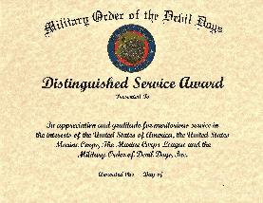
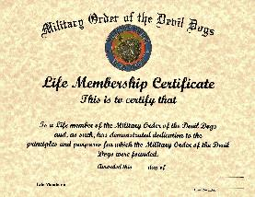
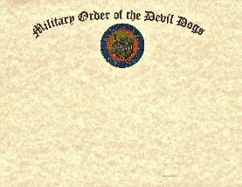

General Awards
These Certificates may be awarded on the Pound, Pack or Kennel level. (no medal or ribbon).
  MODD Certificate of Appreciation.
    May be awarded to a Dog, business or non-member.
      No specific criteria.
  MODD Distinguished Service Award
    May be awarded to a Dog, business or non-member.
      No specific criteria.
  MODD Life Membership Certificate.
    May be awarded to a Dog after they become an MODD Life Member.

Slide 4
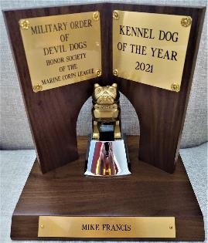
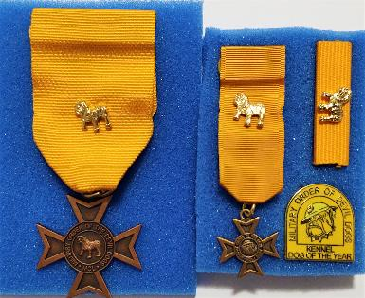
Kennel Awards 1
Kennel Dog of the Year Medal (and ribbon).
  The most prestigious award presented by the Order.
  Must be a PDD.
  Must be in good standing with the MODD and MCL to include paid membership dues.
  A proposed candidate shall be a Dog of integrity, principles and who has contributed to the MODD.
  The rules for nomination, submission and selection are covered in the Section 417 of the Kennel Bylaws.

Slide 5
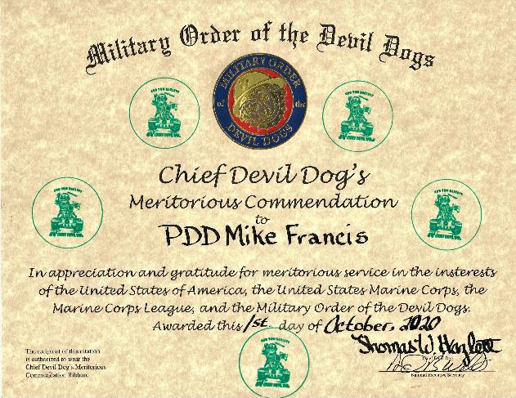
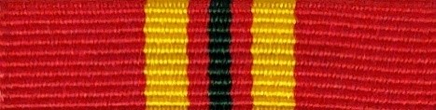
Kennel Awards 2
Chief Devil Dog’s Meritorious Commendation Ribbon (Individual).
  Recognition for exceptionally meritorious service to the Kennel.
  Awarded by the Honorable Chief Devil Dog.

Slide 6
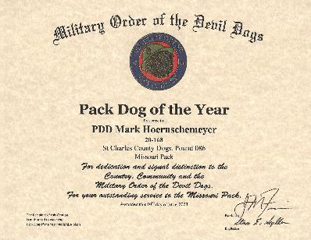
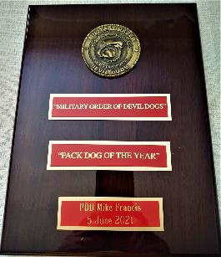
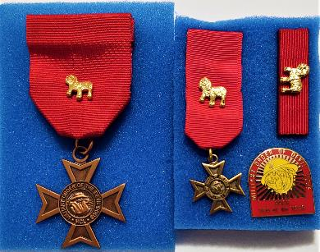
Kennel Awards 3
Pack Dog of the Year Medal (and ribbon).
  The most prestigious award presented by the Pack.
  Must be a PDD or DD.
  Must be in good standing with the MODD and MCL to include paid membership dues.
  A proposed candidate shall be a Dog of integrity, principles and who has contributed to the MODD.
  The rules for nomination, submission and selection are covered in the Section 417 of the Kennel Bylaws.

Slide 7
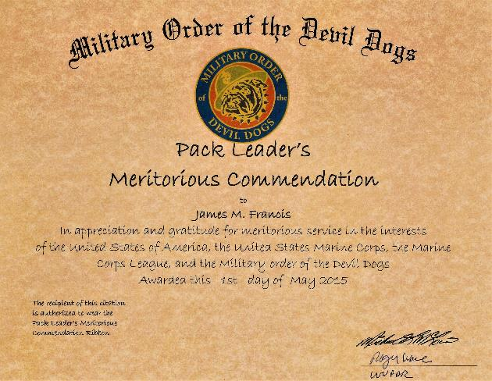

Kennel Awards 4
Pack Leader’s Meritorious Commendation Ribbon (Individual).
  Recognition for exceptionally meritorious service to the Pack.
  Awarded by the Worthy Pack Leader.

Slide 8
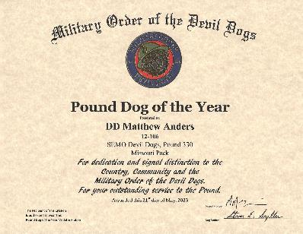
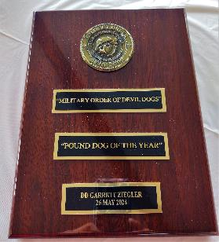
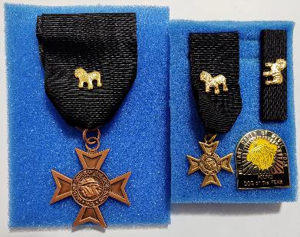
Kennel Awards 5
Pound Dog of the Year Medal (and ribbon).
  The most prestigious award presented by the Pound.
  Can be a PDD or DD or Pup
  Must be in good standing with the MODD and MCL to include paid membership dues.
  A proposed candidate shall be a Dog of integrity, principles and who has contributed to the MODD.
  The rules for nomination, submission and selection are covered in the Section 417 of the Kennel Bylaws.

Slide 9
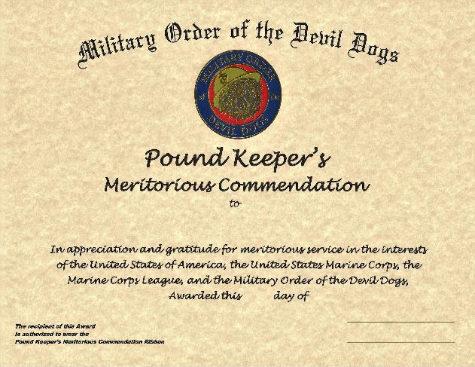

Kennel Awards
Kennel Awards 6
Pound Keeper’s Meritorious Commendation Ribbon (Individual).
  Recognition for exceptionally meritorious service to the Pound.
  Awarded by the Sir/Madame Pound Keeper.

Slide 10
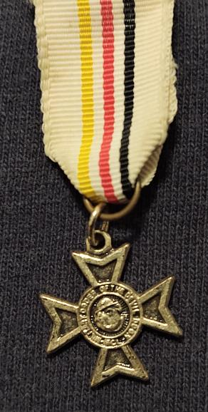

Kennel Awards
Kennel Awards 7
Past Chief Devil Dog Medal (and ribbon).
  Awarded to Chief Devil Dogs upon completion of a term office.

Slide 11
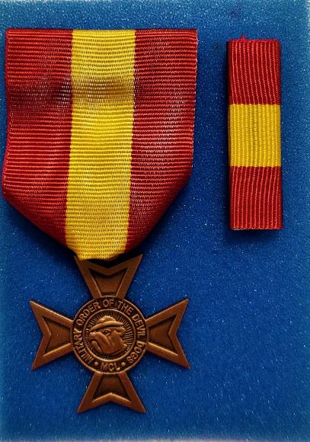
Kennel Awards
Kennel Awards 8
Past Pack Leader Medal (and ribbon).
  Awarded to Pack Leaders upon completion of a term office.

Slide 12
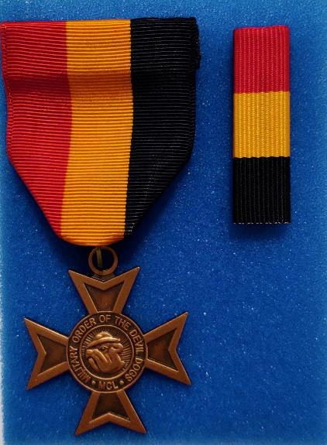
Kennel Awards
Kennel Awards 9
Past Pound Keeper Medal (and ribbon).
  Awarded to Pound Keepers upon completion of a term office.

Slide 13
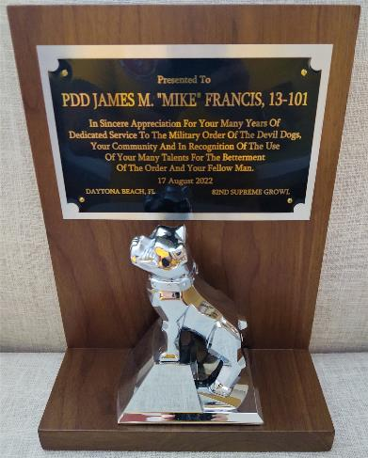
Special Kennel Awards 1
Past Chief Devil Dog Award (no medal or ribbon).
  Presented by the Past Chief Devil Dogs Society to a PDD in recognition of their exceptional service to the MODD and to their community. This award is second only to the Kennel Dog of the Year as the most prestigious award given by the MODD.

Slide 14
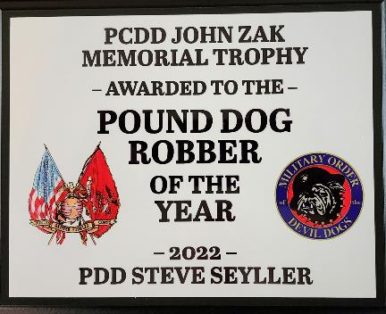
Special Kennel Awards 2
PCDD John Zak Award (no medal or ribbon).
  Recognizes the outstanding Pound Dog Robber of the Year.
  Candidates must have a minimum of three (3) years in office.
  Nomination Letter must be signed by the Pound Keeper and endorsed by another elected Pound Officer.
  The rules for nomination, submission and selection are covered in Enclosure 1 of the Kennel Bylaws.

Slide 15
Special Kennel Awards 3
PCDD Kenneth E. Farris Award (no medal or ribbon).
  Recognizes the outstanding Pack Dog Robber of the Year.
  Candidates must have a minimum of three (3) years in office.
  Nomination Letter must be signed by the Pack Leader and endorsed by another elected Pack Officer.
  The rules for nomination, submission and selection are covered in Enclosure 1 of the Kennel Bylaws.

Slide 16
Kennel Membership Awards 1
PCDD Gerald L. Bakelaar Award (no medal or ribbon).
  Named after the first Chief Devil Dog.
  Awarded to the top Pound in the Kennel for membership during the previous fiscal year.

Slide 17
Kennel Membership Awards 2
PDD Howard D. Goslin Award (no medal or ribbon).
  Named after an outstanding Devil Dog.
  Awarded to the top Pack in the Kennel for membership during the previous fiscal year.

Slide 18
Kennel Membership Awards 3
PDD James F. Powell Award (no medal or ribbon).
  Named after an outstanding Kennel Quartermaster.
  Awarded to the top Division in the Kennel for membership during the previous fiscal year.

Slide 19
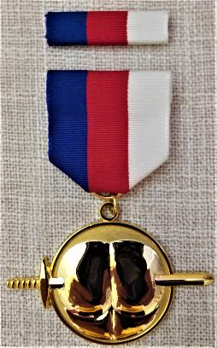
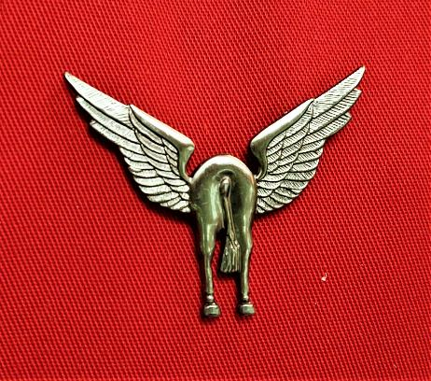
Unofficial Awards 1
There are an unlimited number of Unofficial Awards. The Honorable Quartermaster carries some of them in the Kennel Store. You are only limited by your imagination. We are the “Fun and Honor Society.” Be creative!
Pain in the Azz Medal
Flying Horse’s Azz Award

Slide 20
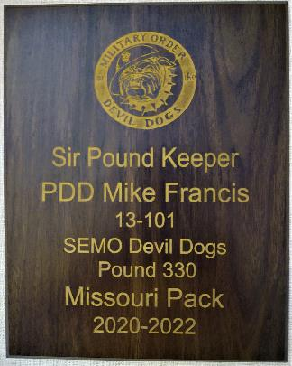
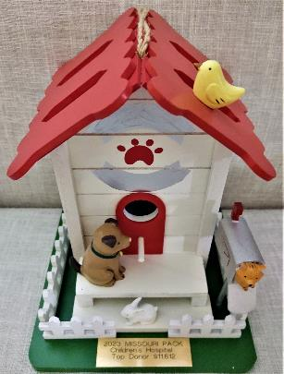
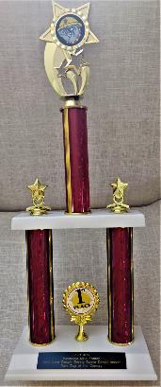
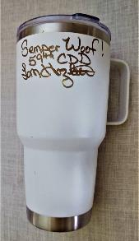

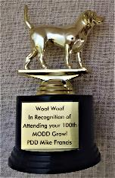

Unofficial Awards 2
There are an unlimited number of Unofficial Awards. You are only limited by your imagination. We are the “Fun and Honor Society.” Be creative!

