Slide 1


MODD Forms
GGGGGRRRRR !!!
Dogs HATE paperwork…

Slide 2

Blank Forms
MODD blank forms can be found on the Kennel website.
  MilitaryOrderoftheDevilDogs.org
Go to the “Library” tab and click on “Publications.”
Scroll down to the Forms section.
These are fillable forms. You can download them and type in all information before printing the form. Our goal is to have all MODD forms typewritten. Make sure you save a copy to your computer so you can email it.

Slide 3
List of Forms
New Membership Application.
  Page 2 is for Dual Membership.
Application for Degree Advancement.
Request for Transfer.
Notice of Death.
Charter Application.
Transmittal.
Installation of Officers (ROI).
Operation Chow Hound Reporting Form.

Slide 4
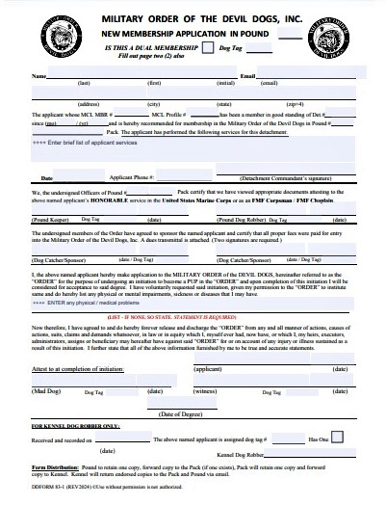
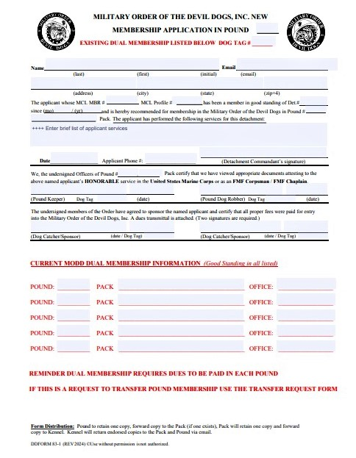
New & Dual Membership Application
Follow the Directions in the MODD Dog Robber Manual.
Use page number 1 for New Members and page number 2 for Dual Membership.
Fill in all blocks!
MCL Membership Number, NOT PLM Number.
Detachment Commandant must sign.
Applicant must sign and date.
Follow the Form Distribution instructions.

Slide 5
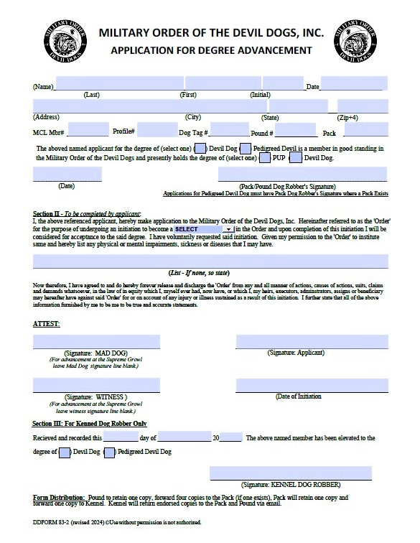
Application for Degree Advancement
Filling out the Application for Degree Advancement correctly is instrumental in assuring that your Dogs are advanced when they are qualified.
Follow the Directions in the MODD Dog Robber Manual.
MCL Membership Number, NOT PLM Number.
Applications for Pups advancing to DD must be signed by the POUND Dog Robber.
Applications for DDs advancing to PDD must be signed by the PACK Dog Robber.
Make sure the Applicant lists any physical problems that might be of concern for the initiation. If none exist, write “NONE.”
Don’t forget to have the applicant sign and date the Application!
The signature blocks for MAD DOG, WITNESS and DATE OF INITIATION will be blank until AFTER the Initiation and Obligation.
Follow the Form Distribution instructions.

Slide 6
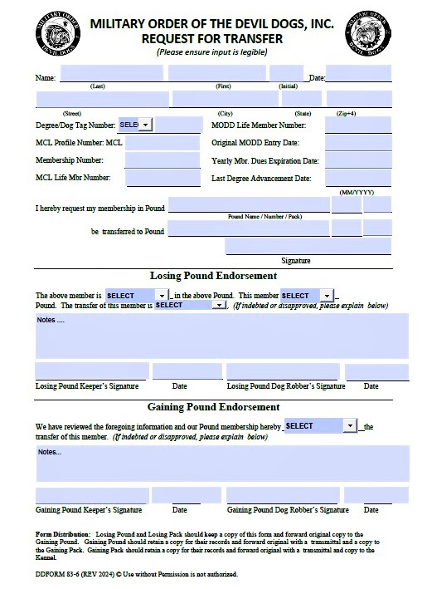
Request For Transfer
Follow the Directions in the MODD Dog Robber Manual.
MCL Membership Number, NOT PLM Number.
Applicant must complete the top of the transfer form.
The losing pound should endorse the transfer.
The losing Pound can only deny the transfer if the Dog is indebted to the Pound or has pending Disciplinary Charges.
This transfer is subject to approval by the membership of the gaining Pound.
The Gaining Pound must submit this form with a Transmittal.
Follow the Form Distribution instructions.

Slide 7
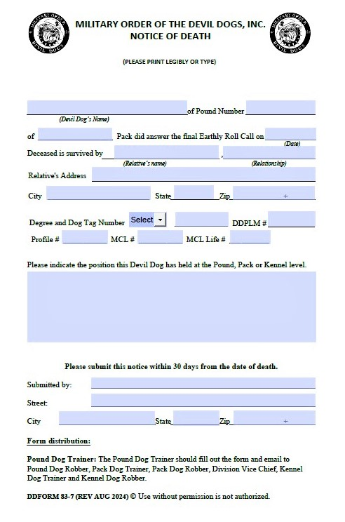
Notice of Death
As soon as possible after being informed of the death of a Member, the Dog Trainer (with the assistance of the Dog Robber) should complete the Notice of Death form.
Follow the Directions in the MODD Dog Robber Manual.
MCL Membership Number, NOT PLM Number.
A copy of the Notice of Death should be made for the Dog Robber's records.
Follow the Form Distribution instructions.

Slide 8
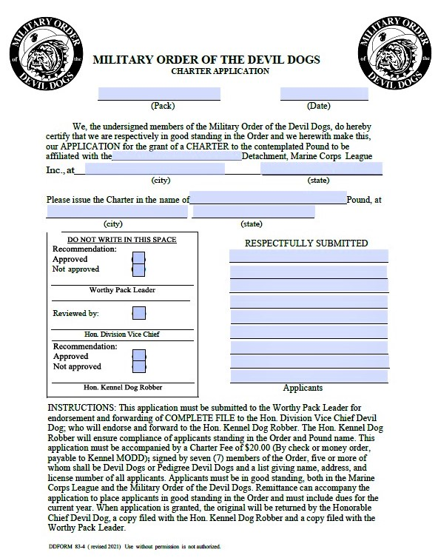
Charter Application
Follow the Directions in the MODD Dog Robber Manual.
Remember, when the Charter Application is submitted it must have at least 7 signatures and 5 of them must be of Dogs who are Devil Dogs or Pedigree Devil Dogs.
The application is accompanied by a 20 Big Bone ($20.00) Payment.
Check or Money Order ONLY, do not send cash.
Follow the Instructions at the bottom of the form.

Slide 9
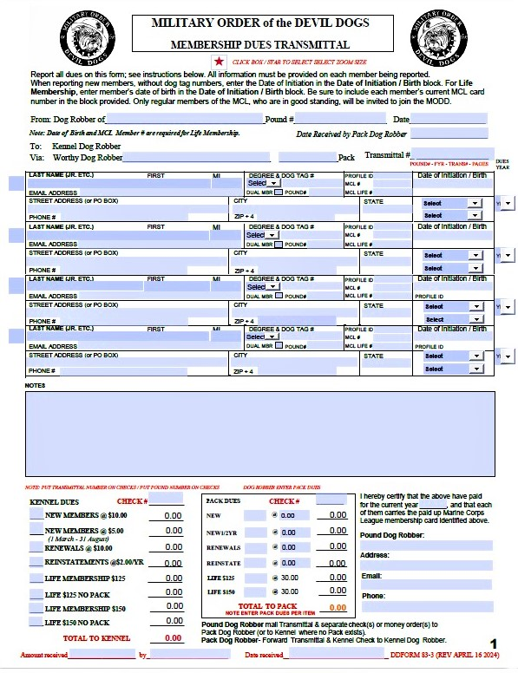
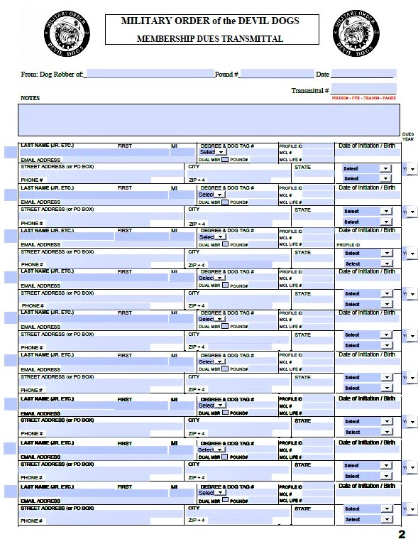
Transmittal
Follow the Directions in the MODD Dog Robber Manual.
Incomplete forms will be rejected.
MCL Membership Number, NOT PLM Number.
Kennel Dues for a New Member are 10 Big Bones ($10.00).
  New Pups being initiated between 1 March and 31 August will be assessed 5 Big Bones ($5.00) Kennel Dues.
Applicants for MODD Life Membership MUST already have an MCL Life Membership.
Forms submitted without the necessary fees and supporting paperwork will be returned.

Slide 10
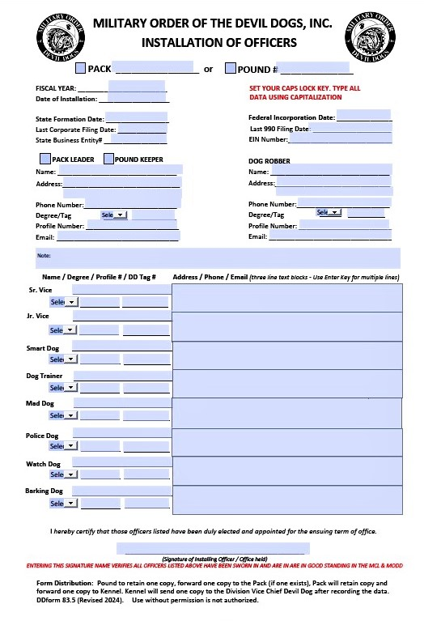
Installation of Officers (ROI)
PLEASE utilize the fillable form on the Kennel website and type the information. Our goal is to have all MODD forms typewritten. Illegible hand written forms will be returned.
Follow the Directions in the MODD Dog Robber Manual.
All Officers on the form must be in good standing with the MODD and MCL to include paid membership dues.
MCL Profile Number, NOT MCL Membership Number or PLM Number.
Fill in ALL sections with complete and accurate information.
List individual address, phone number and email address for each Officer. You cannot use the same information for all of them.
The Installing Officer MUST Sign the Installation Report.
Follow the Form Distribution instructions.

Slide 11
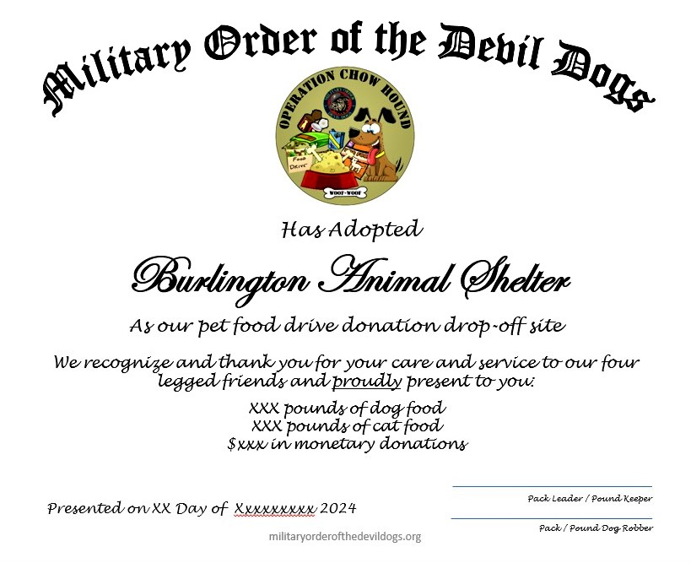
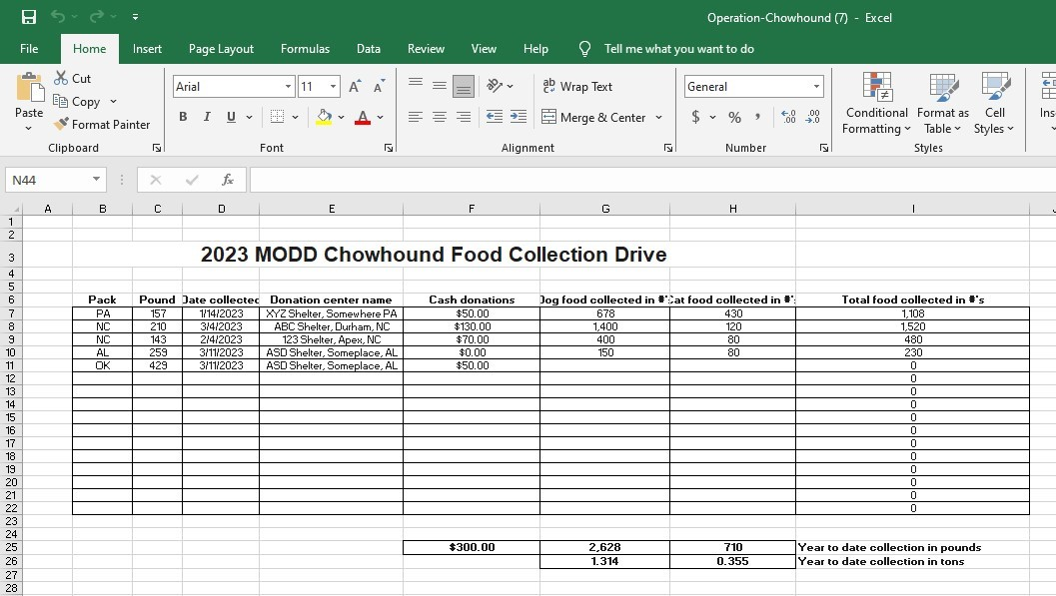
Operation Chow Hound
Operation Chow Hound is a voluntary program.
Pounds and Packs may donate Big Bones, dog & cat food and other supplies to their local no kill animal shelter.
Download the spreadsheet and track the donations from your Pound or Pack.
The reporting period ends on 30 June each year.
All annual reports should be emailed to the Honorable Jr. Vice Chief Devil Dog.

