Slide 1


REPORTING
REQUESTING PERMISSION TO BARK, PROPERLY

Slide 2
A STEP BY STEP EXAMPLE
STAND ON YOUR HIND PAWS (IF ABLE)
RAISE YOUR CLENCHED RIGHT PAW ABOVE YOUR SHOULDER
BARK “WOOF WOOF HONORABLE CHIEF DEVIL DOG”, OR “WOOF WOOF WORTHY PACK LEADER” OR “WOOF WOOF SIR or MADAME POUND KEEPER”
WAIT TO BE ACKNOWLEDGED BY A CORRESPONDING “WOOF WOOF” FROM THE DOG YOU BARKED AT
UPON RECEIPT OF THE ACKNOWLEDGING BARK, YOU ARE NOW FREE TO BEGIN YOUR REPORT.

Slide 3
A STEP BY STEP EXAMPLE CONTINUED
YOU WILL BARK “PDD (OR DD OR PUP AS APPROPRIATE) YOUR NAME, YOUR MODD DOG TAG #, YOUR POUND NAME, YOUR POUND #, YOUR PACK, YOUR OFFICE and then WOOF WOOF.”
AN EXAMPLE – “PDD C.J. DRESSLER, 01-081 (THOSE ARE ZEROES, NEVER O’S), RGV DIABLO DOGS POUND, 956, TEXAS PACK, HONORABLE DEPUTY WATCH DOG, WOOF WOOF.”

Slide 4
A STEP BY STEP, SIDE BY SIDE EXAMPLE
WOOF WOOF Sir (or Madame) Pound Keeper or Worthy Pack Leader or Honorable Chief Devil Dog
(Wait for the response, WOOF WOOF, from the Dog you are barking at)
PDD Joe Smith (or Pup or DD)
12-103 (you MODD Dog Tag Number) (it is “Zero” never “O”)
Hard Dogs (the name of your Pound)
Pound 123 (your Pound number)
North Dakota Pack (the state your Pack is located in)
Sir Dog Robber, Worthy Barking Dog, Honorable Mad Dog (the Offices you hold Pound, Pack, and Kennel)
WOOF WOOF
WOOF WOOF Sir Pound Keeper
(Wait for the response, WOOF WOOF, from the Dog you are barking at)
PDD Joe Smith
12-103
Hard Dogs
Pound 123
North Dakota Pack
Sir Dog Robber, Worthy Barking Dog, Honorable Mad Dog
WOOF WOOF

Slide 5
A STEP BY STEP EXAMPLE CONTINUED
THE HONORIFIC TELLS US WHAT LEVEL (POUND, PACK or KENNEL) YOUR OFFICE IS AT. YOU DO NOT NEED TO SAY: SIR POUND JR VICE POUND KEEPER, or WORTHY PACK SMART DOG, or HONORABLE KENNEL DEPUTY WATCH DOG.
CORRECT EXAMPLES:
  SIR MAD DOG or MADAME POLICE DOG
  WORTHY SMART DOG or WORTHY BARKING DOG
  HONORABLE DEPUTY POLICE DOG or HONORABLE DOG TRAINER

Slide 6
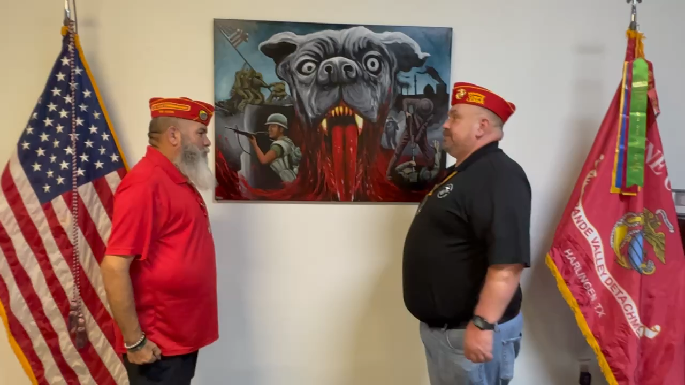
A VIDEO EXAMPLE, REPORTING AT POUND

Slide 7
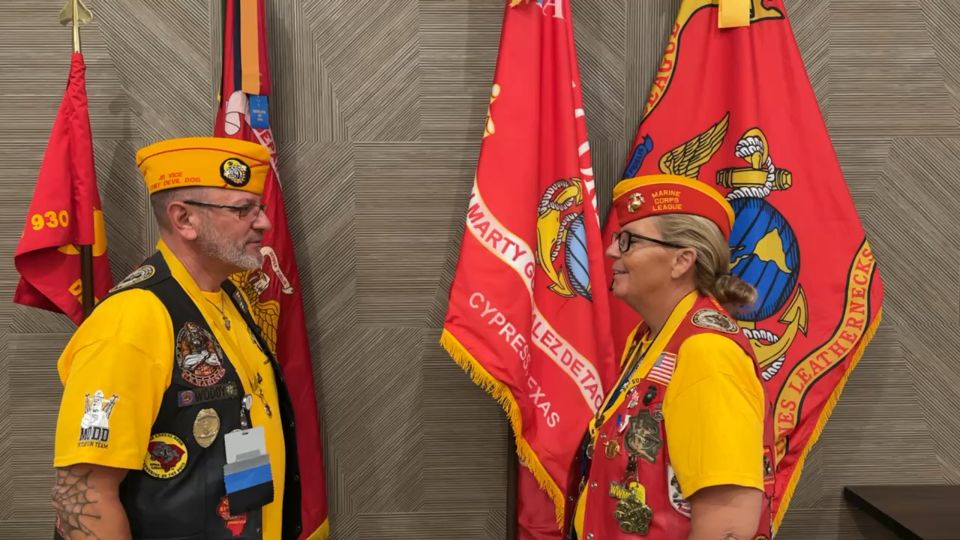
A VIDEO EXAMPLE, REPORTING AT PACK

Slide 8
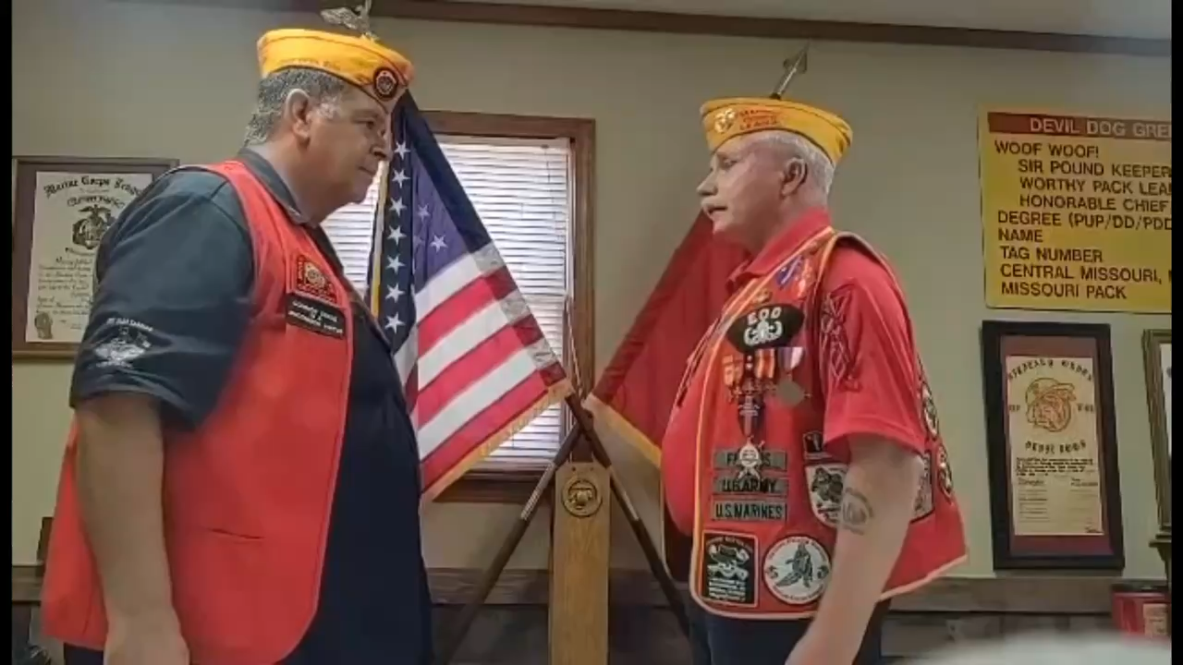
A VIDEO EXAMPLE, REPORTING AT KENNEL

