Slide 1


PASSPORT
HOW TO FILL OUT
PASSPORT STAMPS
PASSPORT FINES
DIRECT DONATIONS

Slide 2
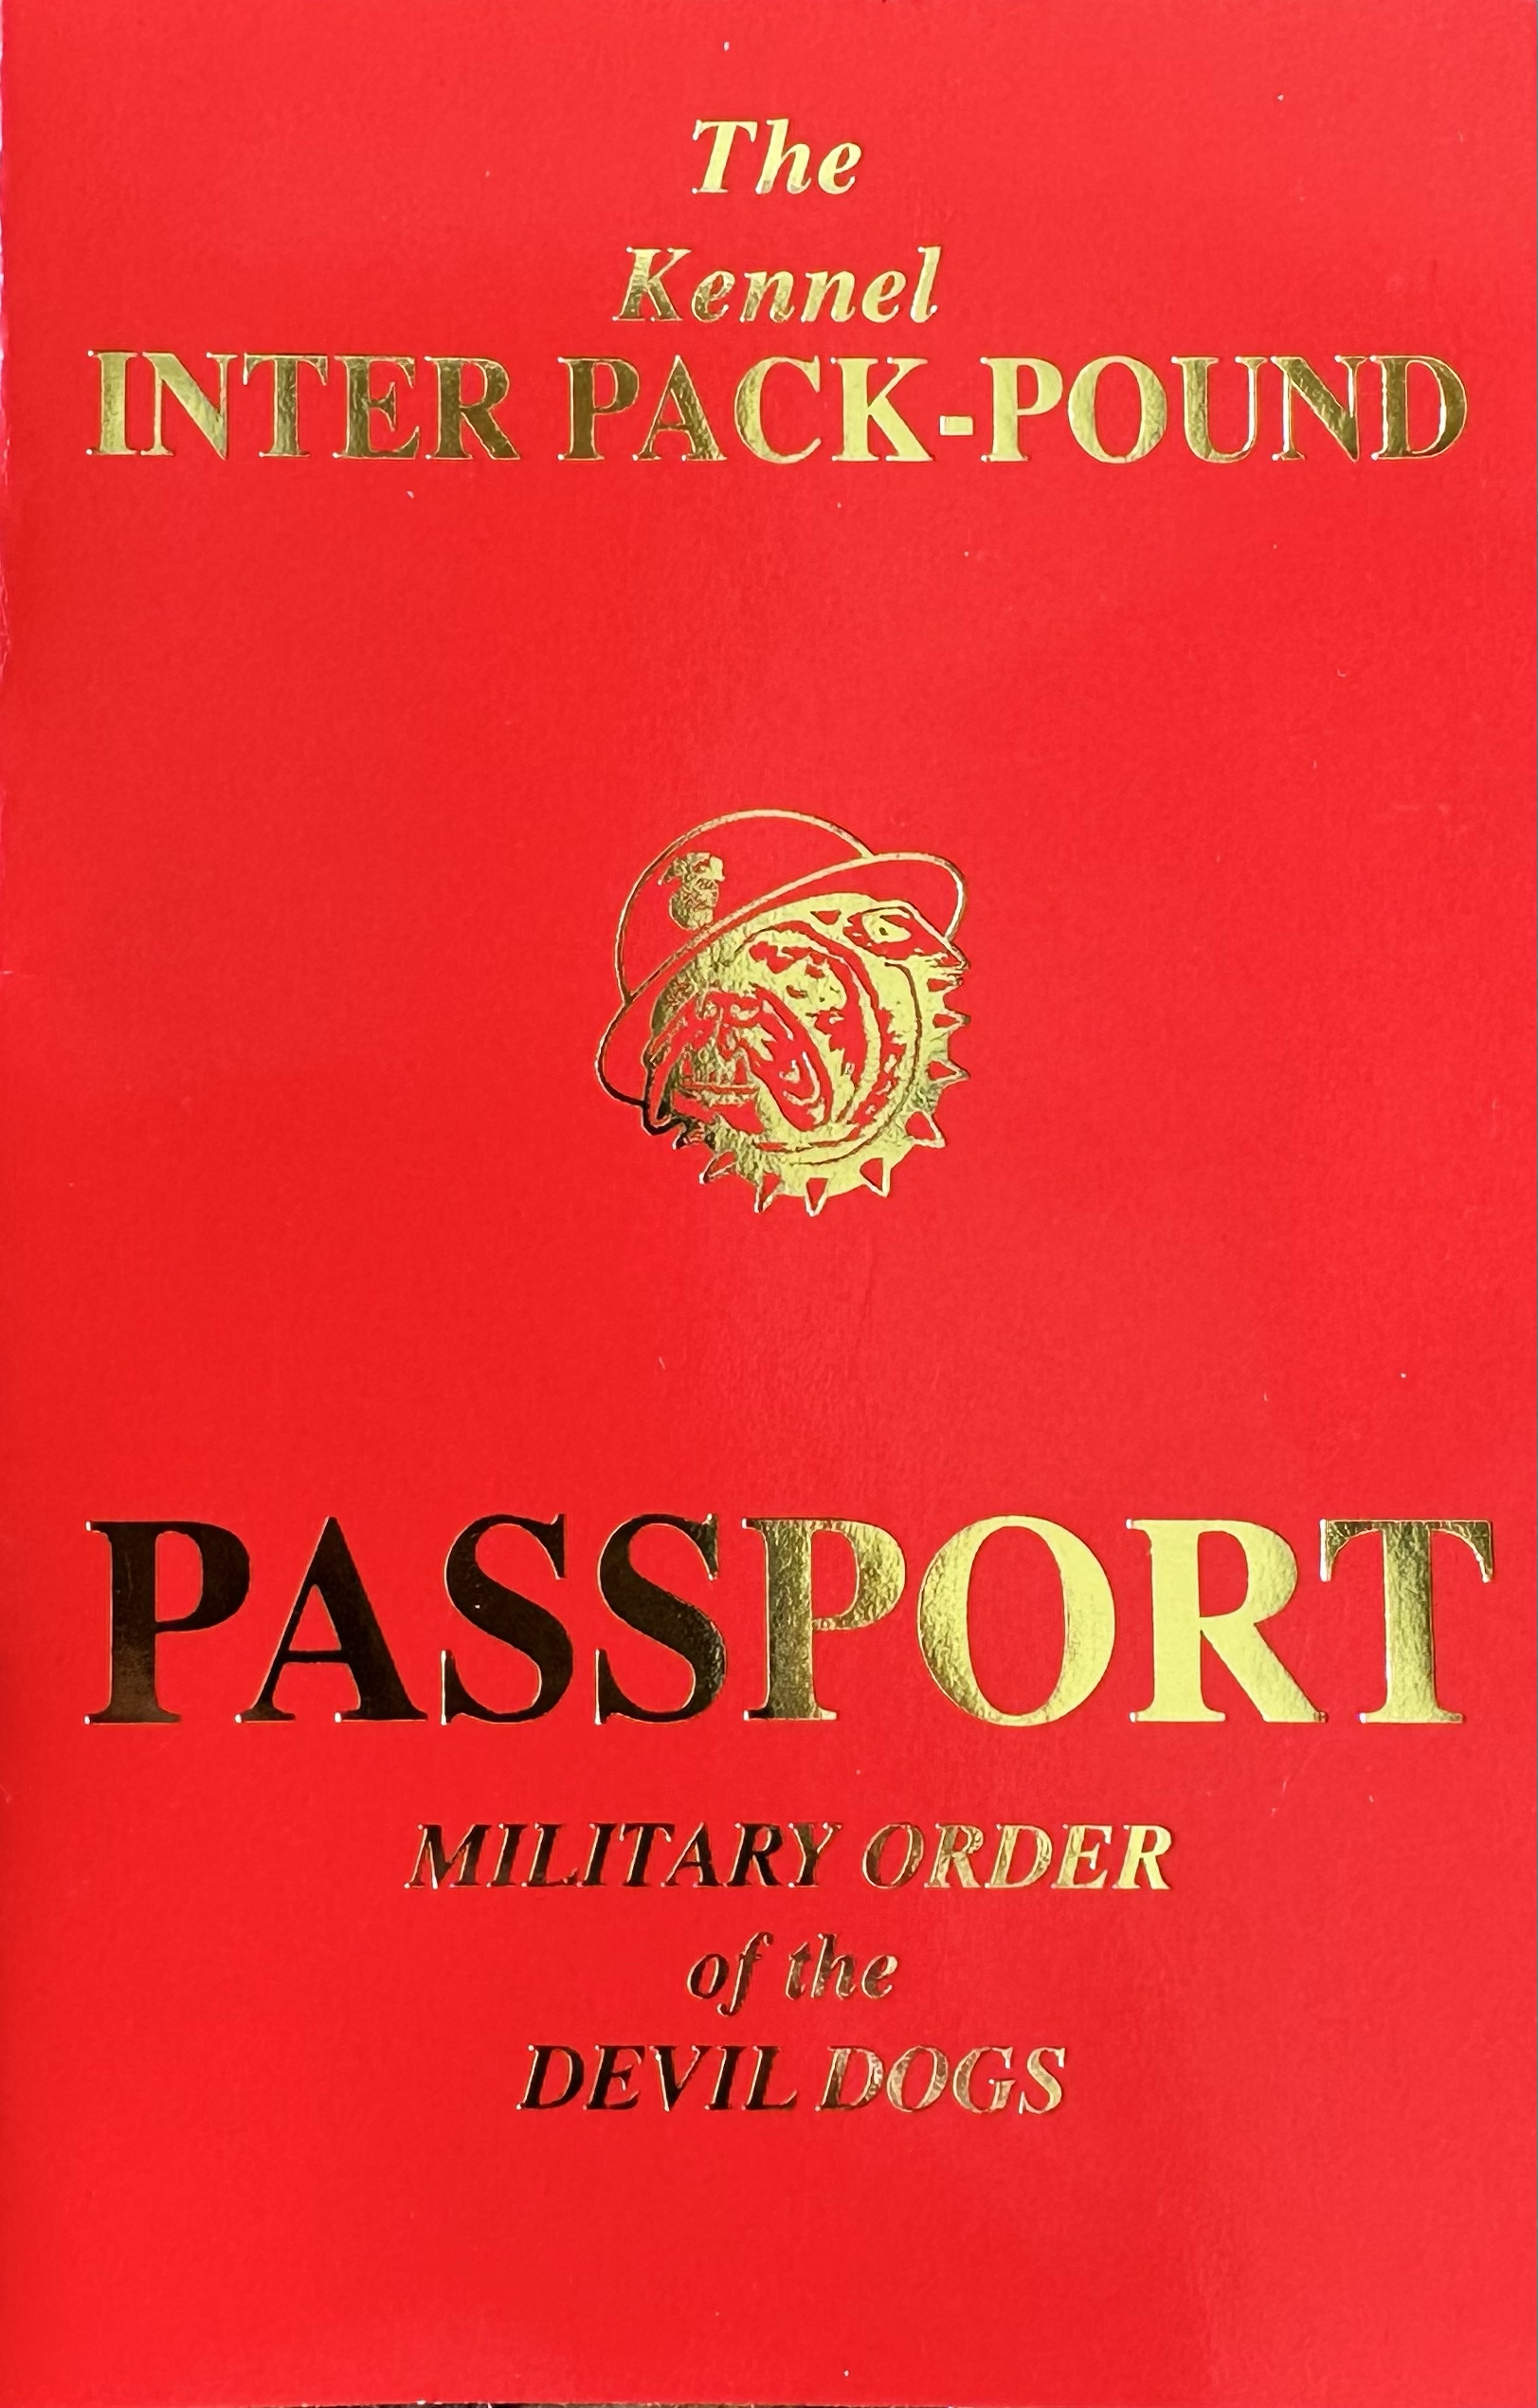
YOUR PASSPORT IS YOUR ENTRANCE DOCUMENT TO ALL OFFICIAL ACTIVITIES OF THE ORDER

Slide 3
INFORMATION PAGES
PERSONAL INFO PAGE
PHOTOGRAPH PAGE
VISA PAGES
NOTES PAGE

Slide 4
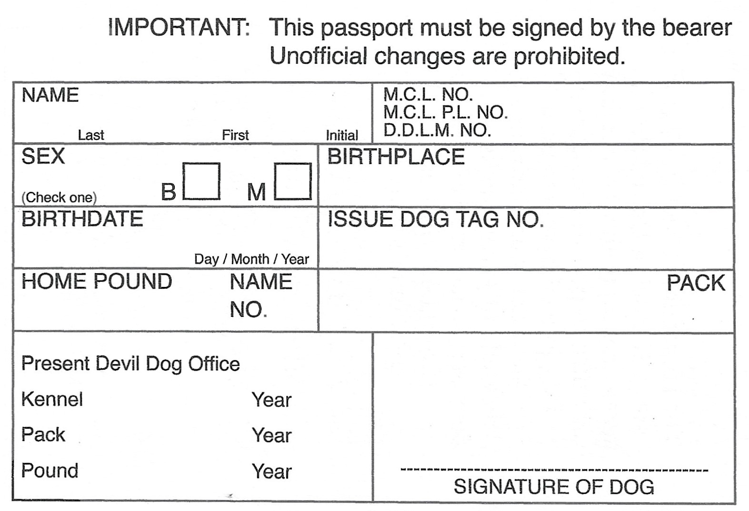
PERSONAL INFORMATION PAGE
LAST NAME, FIRST NAME, MI
MEMBER NUMBERS
  MCL MEMBERSHIP #
  MCL PAID LIFE MEMBERSHIP #
  MODD LIFE MEMBERSHIP #
SEX
BIRTHPLACE (WHERE YOU WERE OBLIGATED AS A PUP)
BIRTHDATE (DATE YOU WERE OBLIGATED AS A PUP)
MODD DOG TAG#
HOME POUND NAME AND POUND #
PACK
CURRENT OFFICES (USE PENCIL)
SIGNATURE

Slide 5
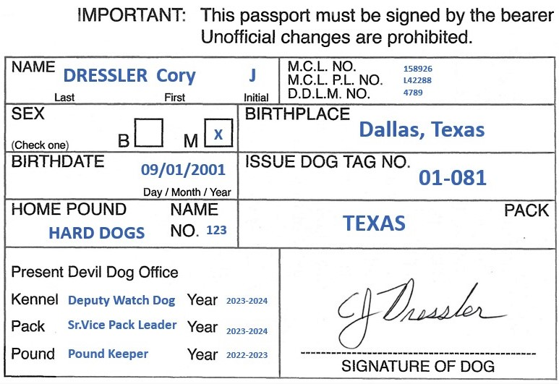
PERSONAL INFORMATION PAGE EXAMPLE
LAST NAME, FIRST NAME, MI
MEMBER NUMBERS
SEX
BIRTHPLACE (WHERE YOU WERE OBLIGATED AS A PUP)
BIRTHDATE (DATE YOU WERE OBLIGATED AS A PUP)
DOG TAG#
HOME POUND NAME AND POUND #
PACK
OFFICES (USE PENCIL)
SIGNATURE

Slide 6
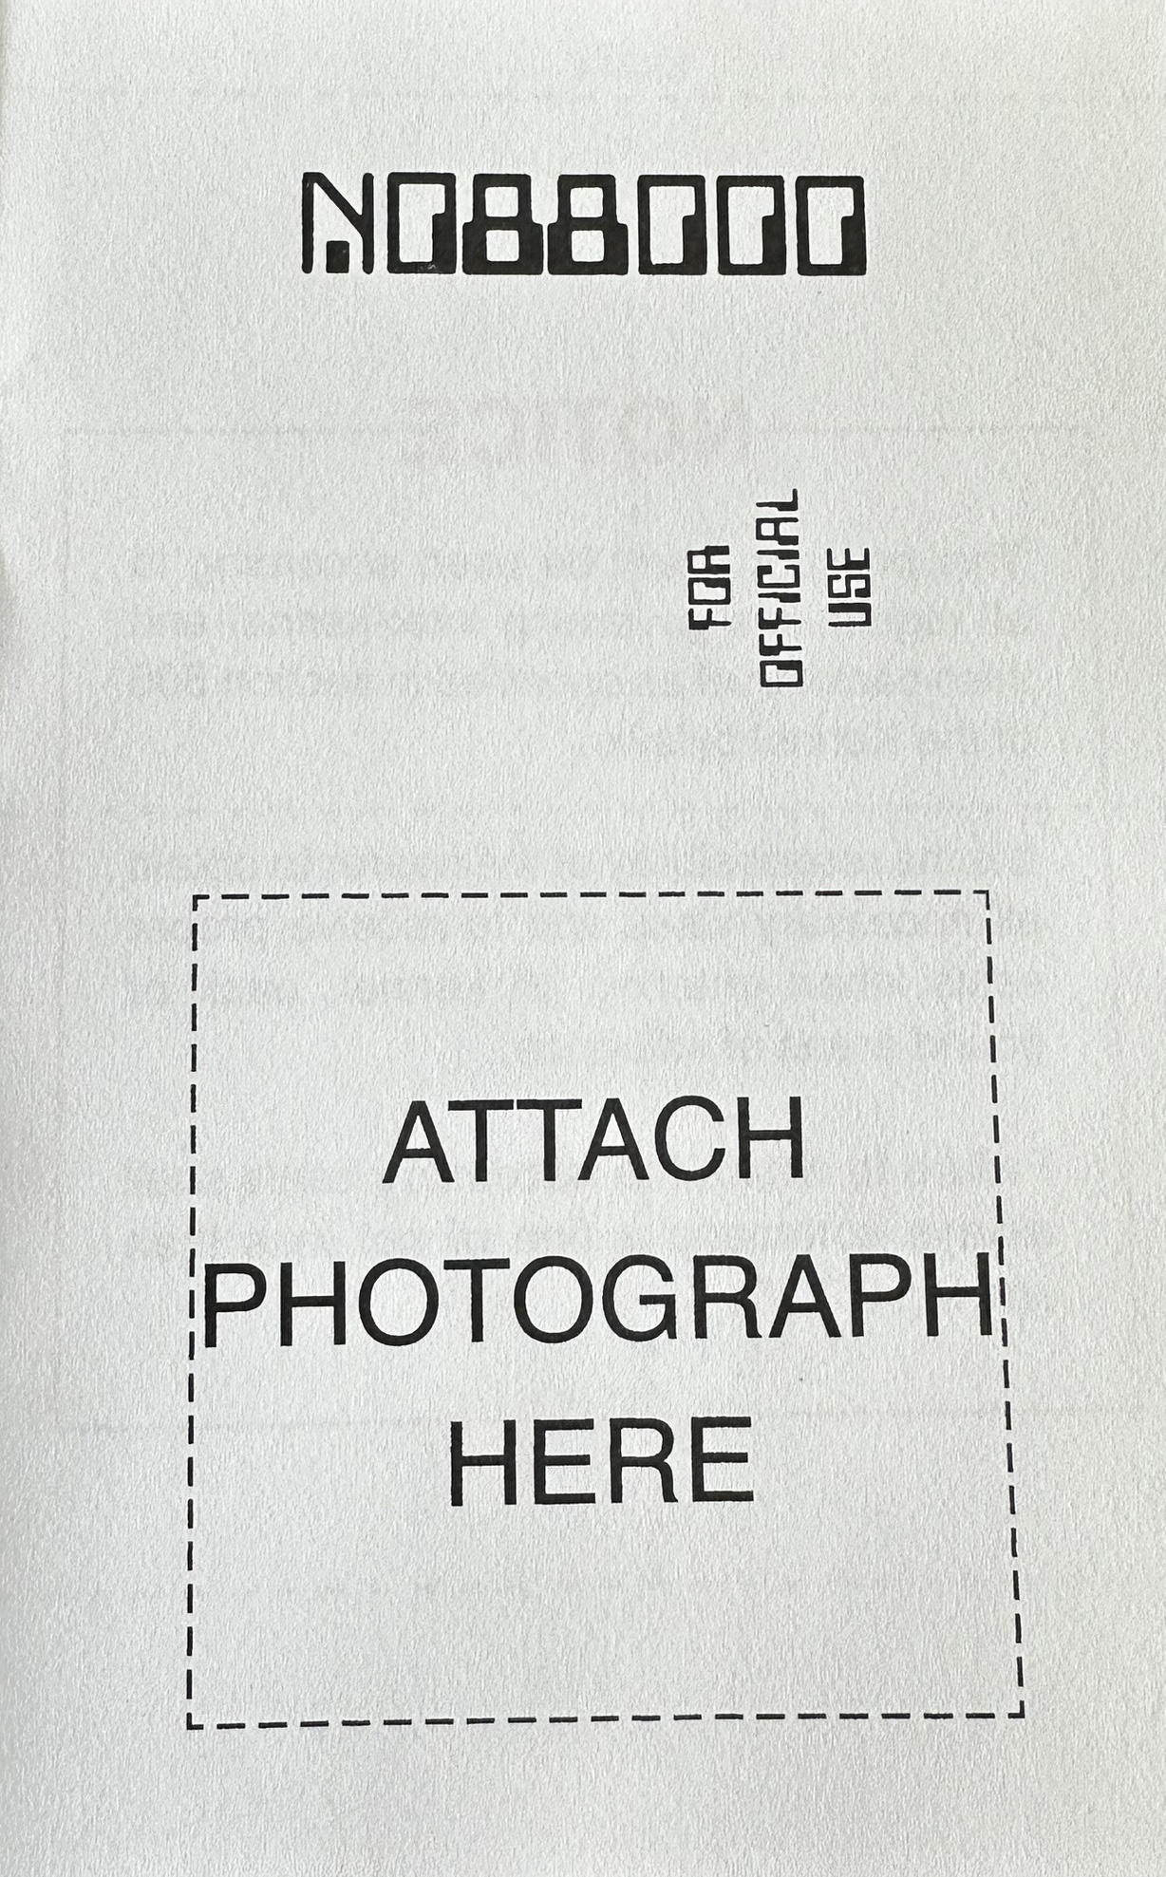
PHOTOGRAPH PAGE
TAPE, GLUE, STAPLE, SEW, OR OTHERWISE AFFIX A PHOTOGRAPH IN THE SPACE SHOWN BELOW
SOME PACKS HAVE REQUIREMENTS FOR THE TYPE OF PHOTO, MUST BE OF A DOG
SOME PACKS WILL STATE IT MUST BE YOU
THE ONLY KENNEL REQUIREMENT IS THAT IT BE A PHOTOGRAPH

Slide 7
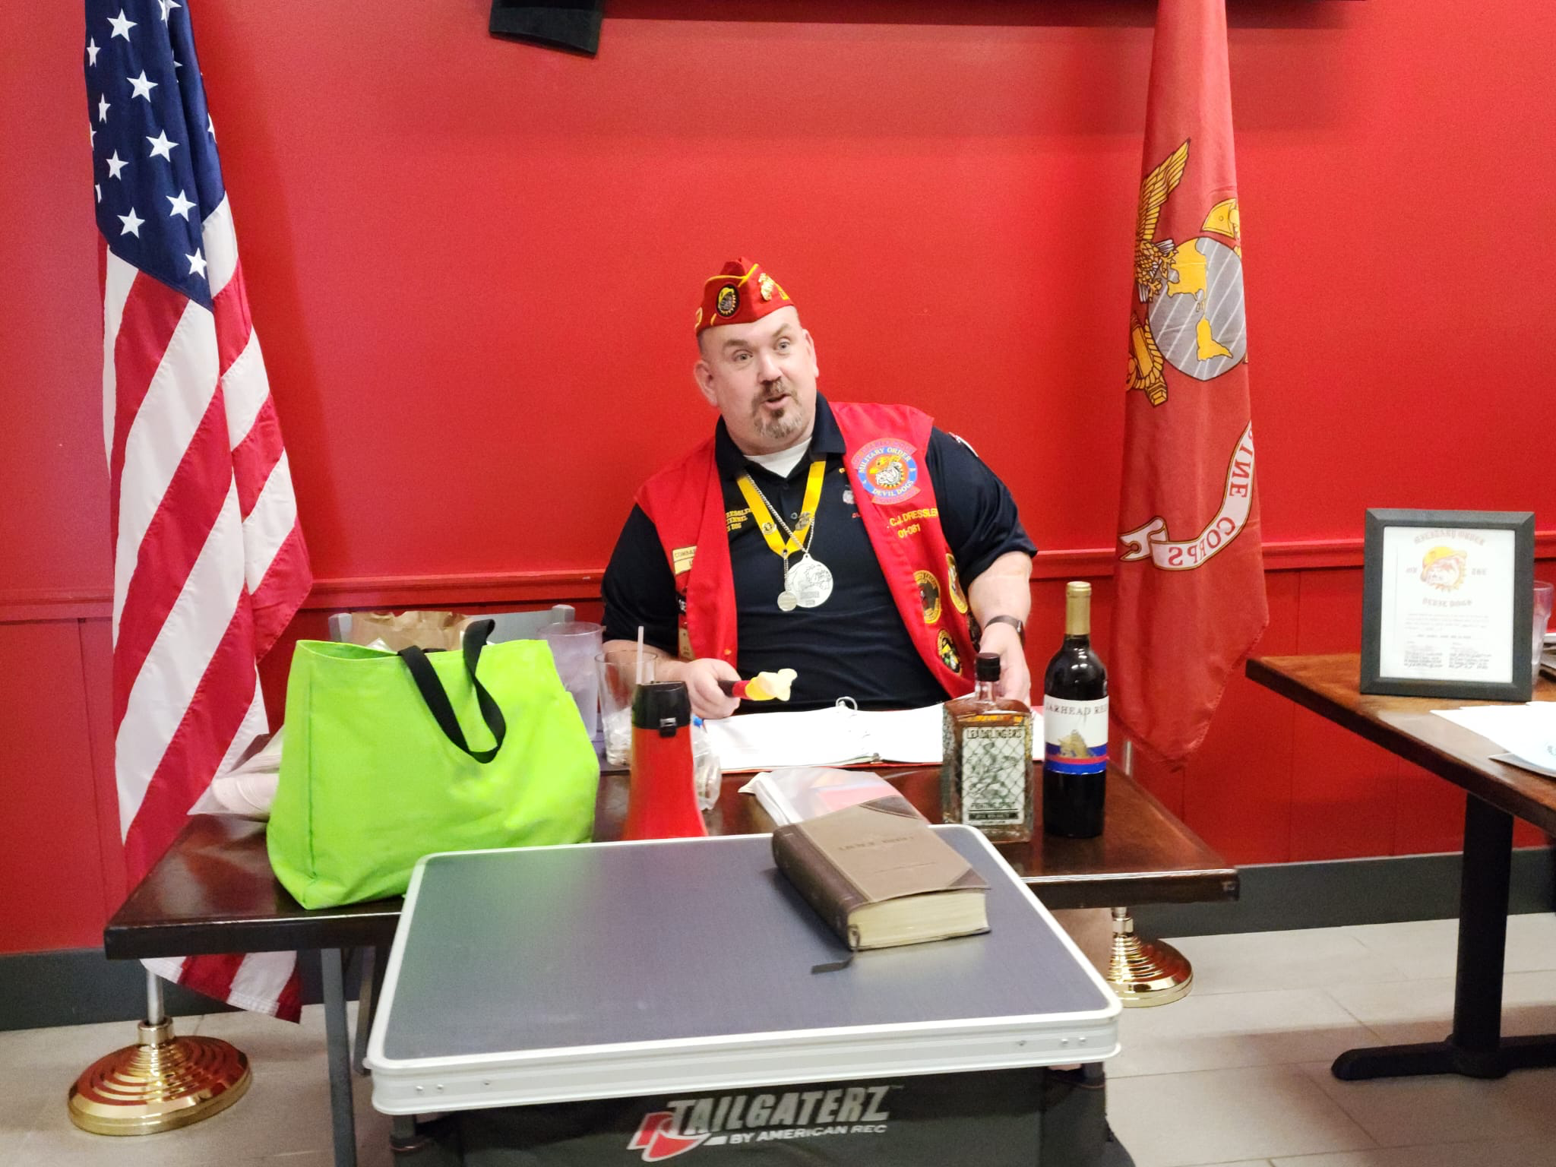
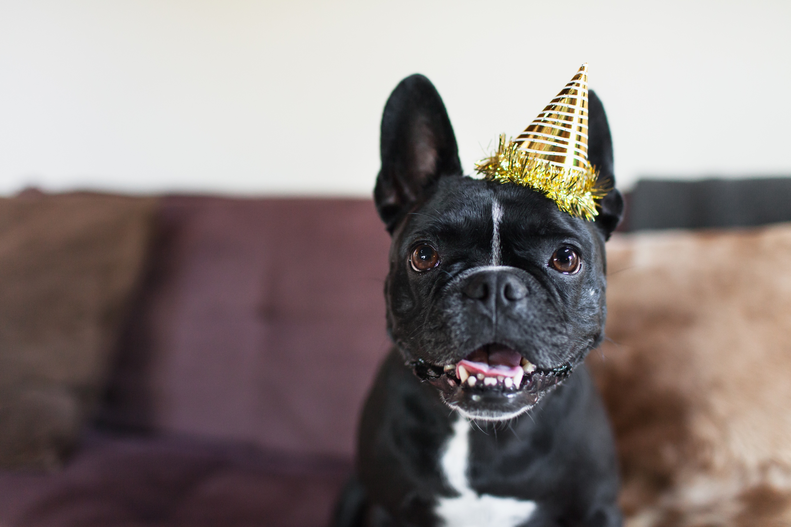
PHOTOGRAPH PAGE EXAMPLES

Slide 8
PASSPORT STAMPS, PASSPORT FINES,
DIRECT DONATIONS
THE COST FOR A PASSPORT STAMP HAS BEEN SET BY THE KENNEL AT ONE BIG BONE ($1.00)
PASSPORT FINES MAY BE LEVIED BY THE DOG ROBBER IF YOUR PASSPORT IS NOT FILLED OUT CORRECTLY
EACH PASSPORT STAMP ENTRY SHALL BE DATED AND INITIALED BY THE DOG ROBBER STAMPING IT
ALL BIG BONES FROM PASSPORT STAMPS, PASSPORT FINES AND DIRECT CONTRIBUTIONS TO THE KENNEL CHILDREN’S HOSPITAL DONATION SHALL BE SENT DIRECTLY TO THE KENNEL DOG ROBBER IMMEDIATELY AFTER EACH GROWL. THESE BIG BONES DO NOT GO TO THE PACK.
  KENNEL PASSPORT FUND IS PAID OUT ANNUALLY DURING THE ANNUAL MCL CONVENTION & SUPREME GROWL TO A CHILDREN’S HOSPITAL IN THE HOST CITY

Slide 9
PASSPORT STAMPS, PASSPORT FINES,
DIRECT DONATIONS, FINES DURING A GROWL
DIRECT DONATIONS TO THE PASSPORT FUND AND PASSPORT FINES CAN BE INCLUDED IN THE SAME CHECK TO THE KENNEL, BUT SHOULD BE ANNOTATED SEPARATELY FROM THE BIG BONES FOR PASSPORT STAMPS
AFTER THE GROWL BEGINS, ANY OTHER BONES/BIG BONES COLLECTED WHETHER THEY BE CALLED FINES, FEES, COLLECTIONS, ARE NOT AUTOMATICALLY SENT IN FOR DEPOSIT IN THE PASSPORT ACCOUNT. THEY BELONG TO THE POUND OR PACK THAT COLLECTED THEM AT THE GROWL
MEMBERSHIP OF THE POUND OR PACK WILL DECIDE HOW THOSE BONES ARE SPENT
IF A DEVIL DOG LOSES THEIR PASSPORT, IT IS TO BE STAMPED 4 TIMES AND RETURNED TO THAT DEVIL DOG AT THE COST OF 2 BIG BONES

Slide 10
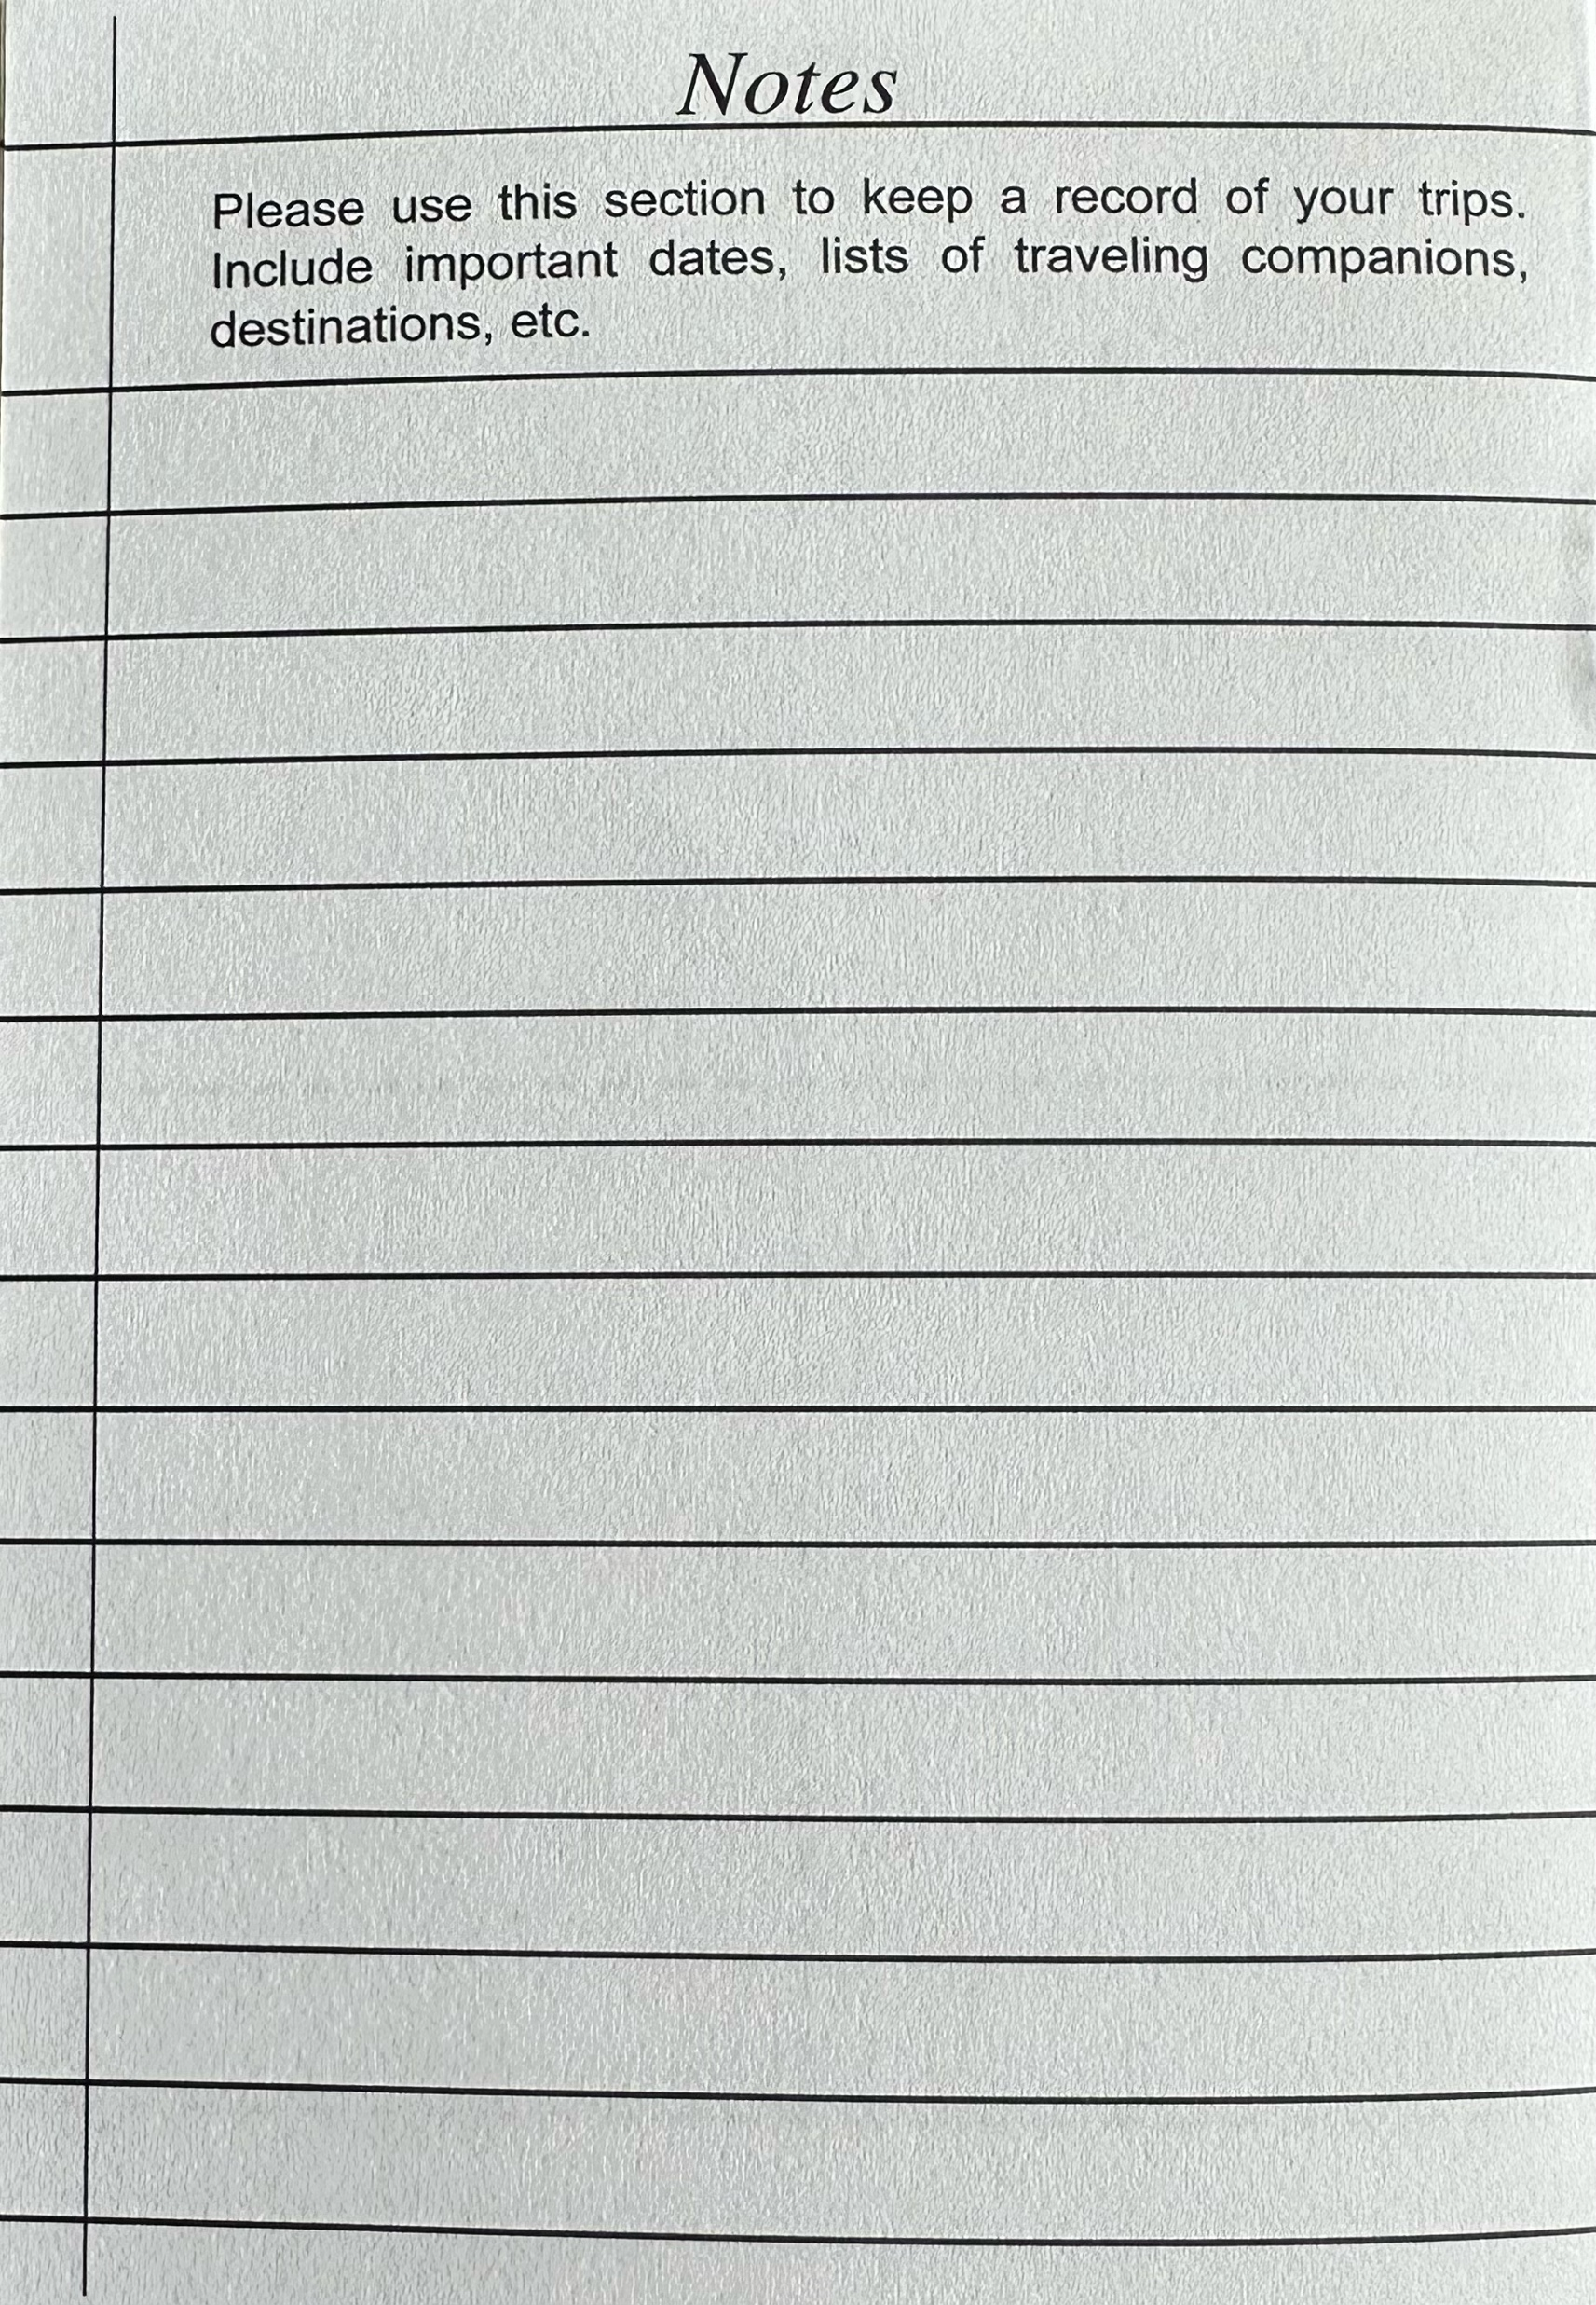
NOTES PAGE
THIS PAGE IS FOR YOUR USE
  GROWLS YOU ATTENDED
  LIST DATES OF CONVENTIONS YOU ATTENDED
  DOGS YOU HAVE MET
  EVENTS YOU PARTICIPATED IN
  ETC

