Slide 1


UNIFORMS – COVERS, COLLARS, AND MODD DOG TAGS
AND WHAT YOU MAY WEAR WITH YOUR MCL UNIFORM

Slide 2
MODD UNIFORM ITEMS
COVERS
MODD COLLARS
MODD DOG TAGS
MODD PATCHES

Slide 3
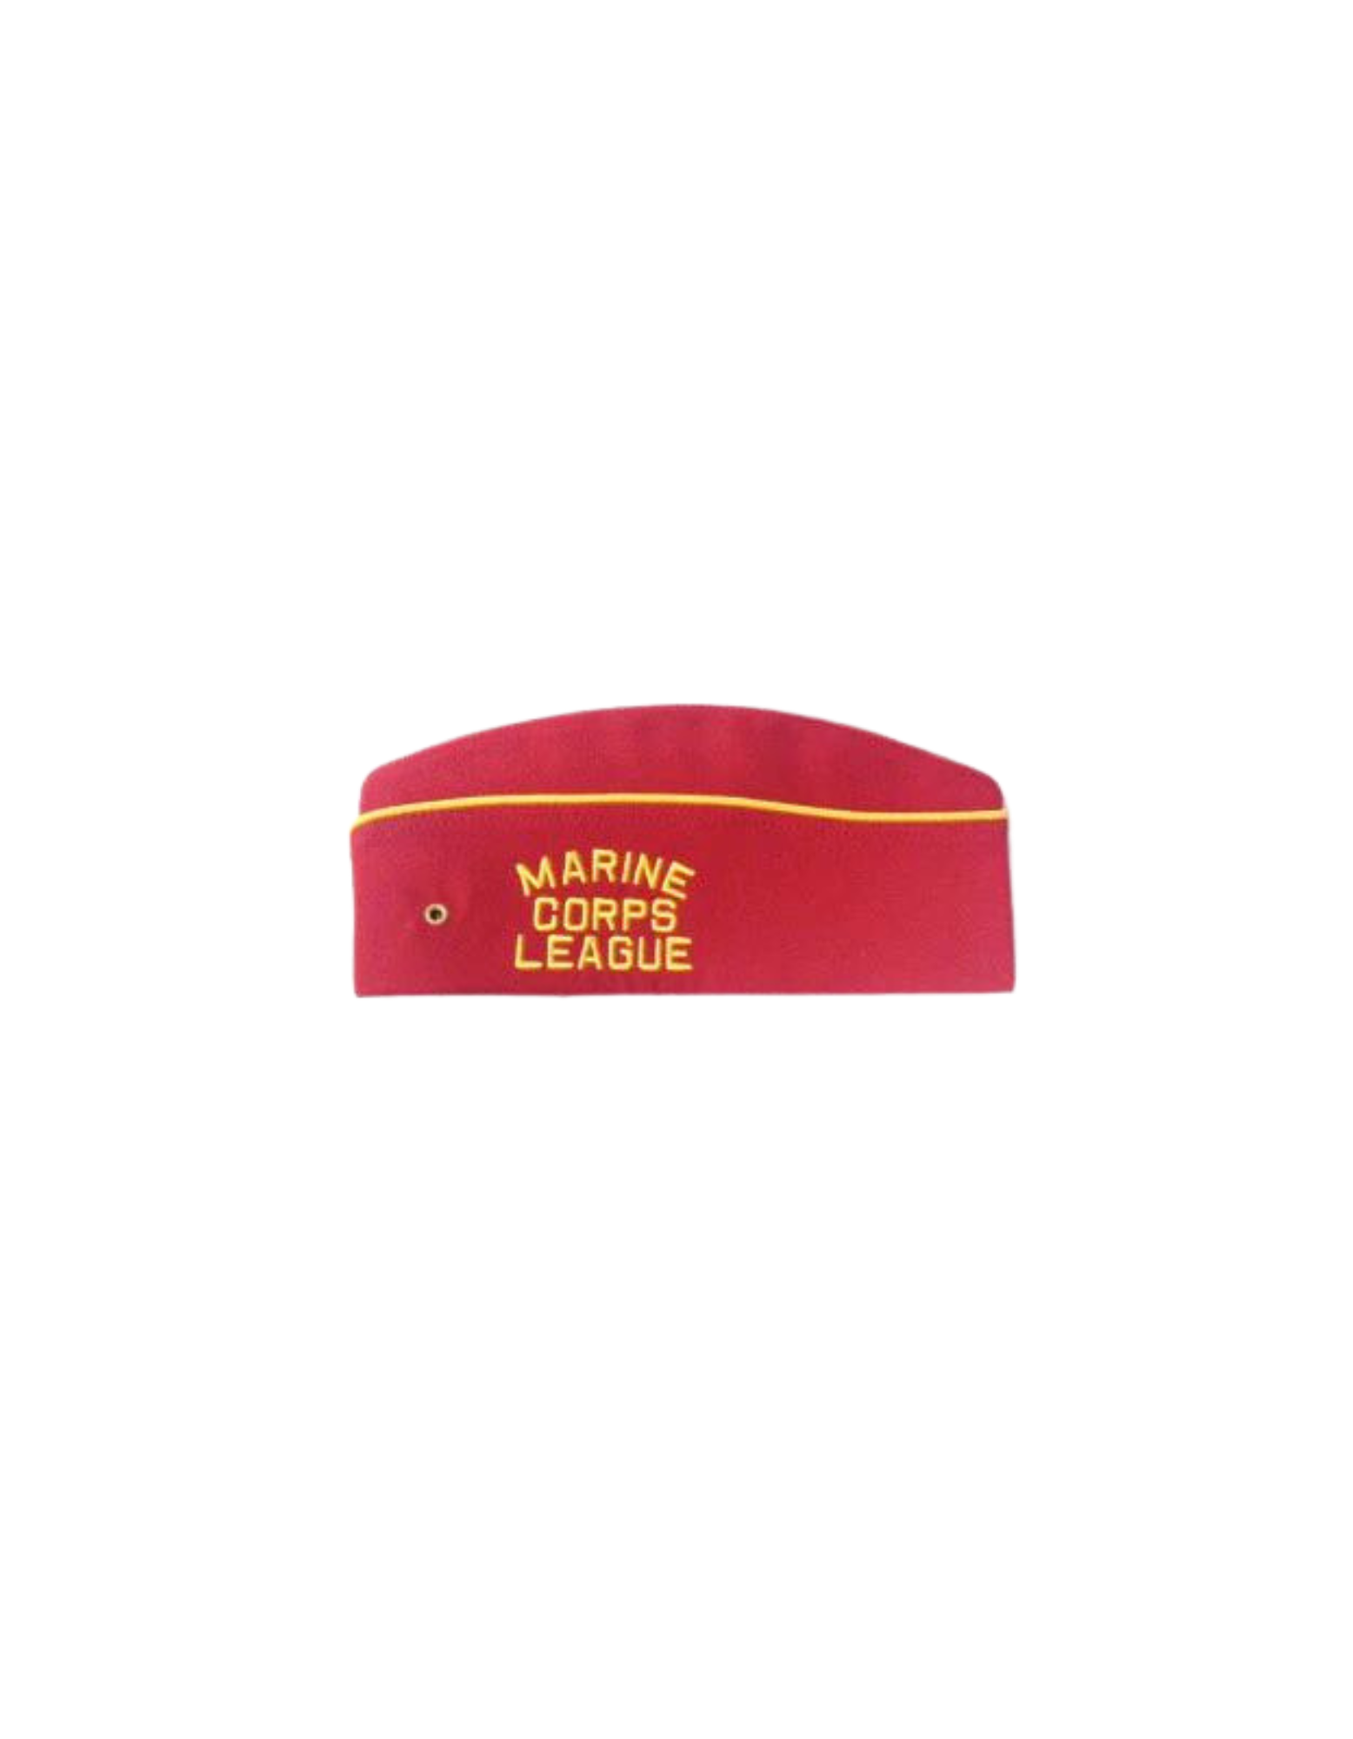
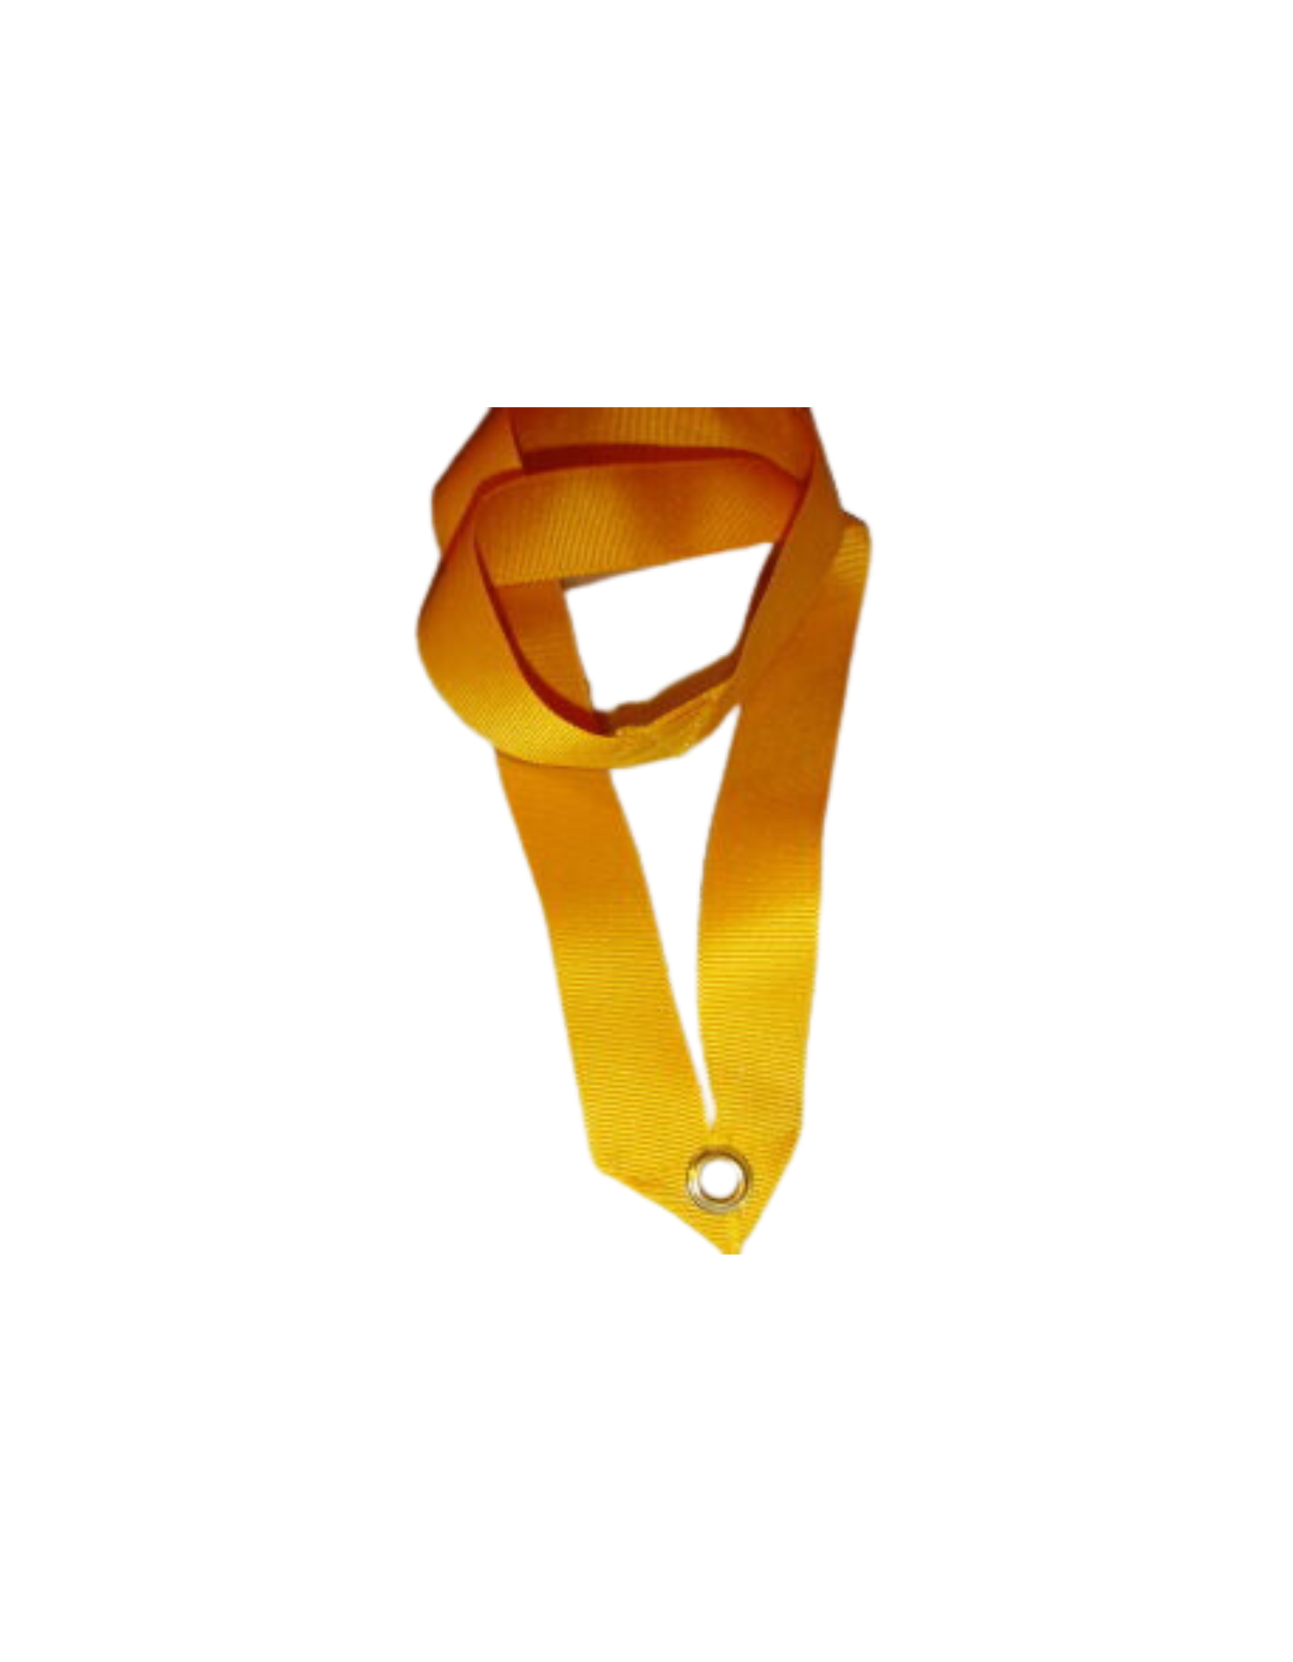
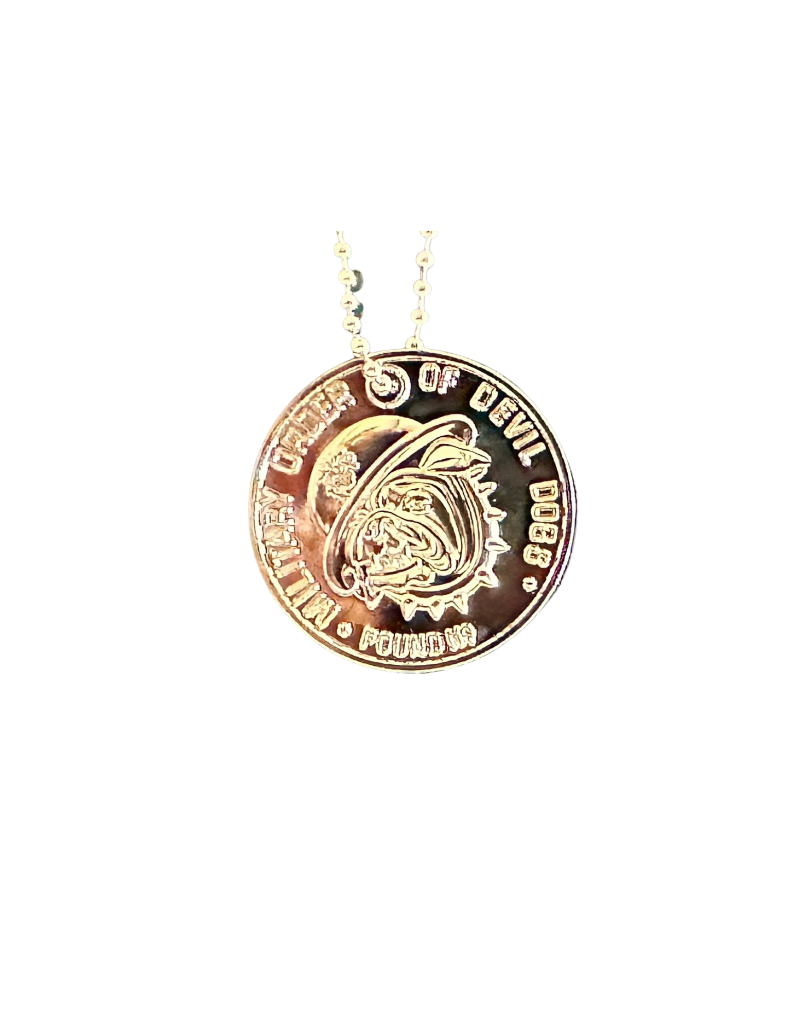
REQUIRED UNIFORM FOR A GROWL
MODD COLLAR
MODD DOG TAG
COVER
OTHER THAN THE CLOTHES THAT ARE REQUIRED FOR COMMON DECENCY, THESE ARE THE ONLY REQUIRED UNIFORM ITEMS FOR A GROWL
* FOR THOSE WHO MAY NEED THE REMINDER, YOU MUST HAVE YOUR MODD PASSPORT, VALID MCL MEMBERSHIP CARD AND VALID MODD MEMBERSHIP CARD TO ENTER A GROWL

Slide 4
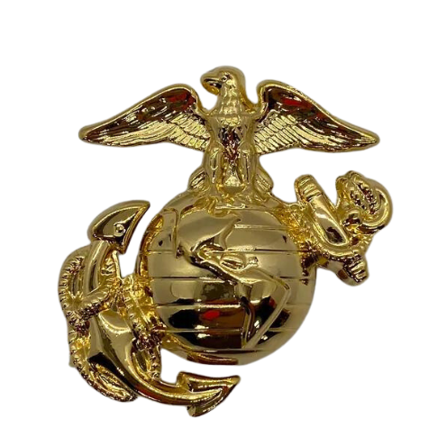
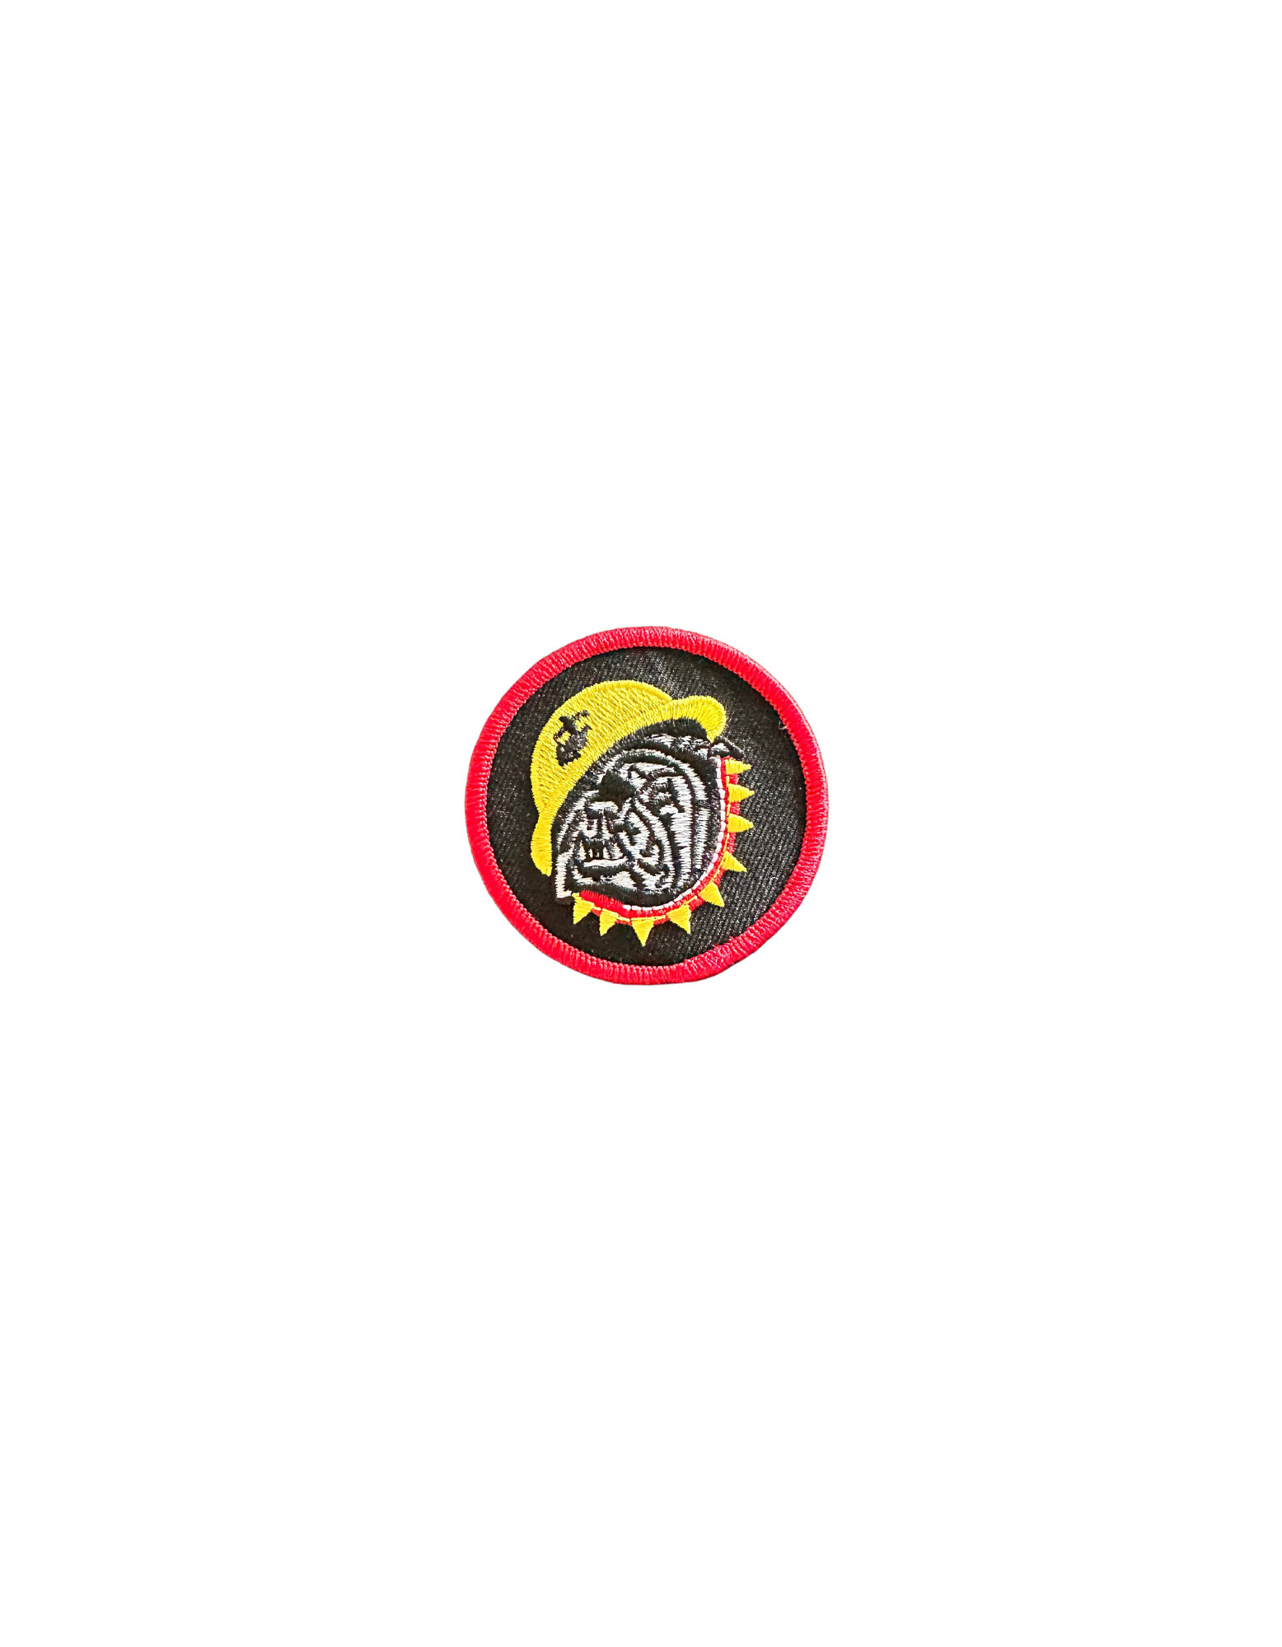
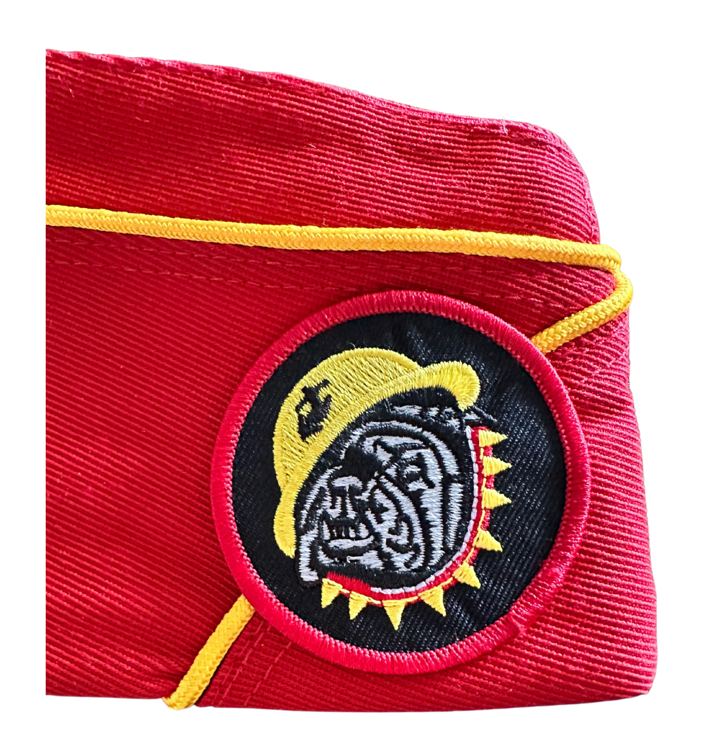
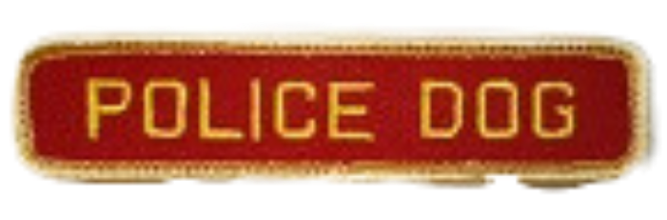
REQUIRED AND AUTHORIZED ITEMS TO WEAR ON MODD COVERS
USMC EGA
MODD COVER PATCH
CAP STRIPS
MUST BE WORN BY ALL MEMBERS OF THE MODD ON THEIR UNIFORM COVER IN THE POST HOLE ON THE FRONT LEFT SIDE OF COVER
MUST BE WORN BY ALL MEMBERS OF THE MODD ON THEIR UNIFORM COVER. SHOULD BE ALIGNED SO THAT THE HELMET ALIGNS WITH GOLD/RED PIPING ON RIGHT SIDE OF COVER
MAY BE WORN IN LIEU OF EMBROIDERING CURRENT OFFICE ON RIGHT SIDE OF COVER. MODD CAP STRIPS WILL NOT BE WORN ON COVERS WITH MCL DETACHMENT/DEPARTMENT CAP STRIPS OR DETCHMENT/DEPARTMENT EMBROIDERY
NO OTHER DECORATION, DEVICE OR ITEM IS TO BE WORN ON THE COVER

Slide 5
MODD COVER PATCHES FOR
MALE STYLE & FEMALE STYLE COVERS
MODD MALE STYLE COVER PATCH
MODD FEMALE STYLE COVER PATCH
THE STANDARD SIZE MODD COVER PATCH FOR ALL MALE STYLE COVERS IS 2¼ INCHES IN DIAMETER.
THE STANDARD SIZE MODD COVER PATCH FOR ALL FEMALE STYLE COVERS IS 1¾ INCHES IN DIAMETER. FEMALE STYLE COVER PATCHES WILL NOT BE WORN ON MALE STYLE COVERS
THE STANDARD SIZE MODD COVER PATCH FOR ALL MALE STYLE COVERS IS 2¼ INCHES IN DIAMETER.
FEMALES MAY CHOOSE TO WEAR THE MALE STYLE COVER WITH THE MALE STYLE COVER PATCH.
THE STANDARD SIZE MODD COVER PATCH FOR ALL FEMALE STYLE COVERS IS 1¾ INCHES IN DIAMETER.
FEMALE STYLE COVER PATCHES WILL NOT BE WORN ON MALE STYLE COVERS

Slide 6
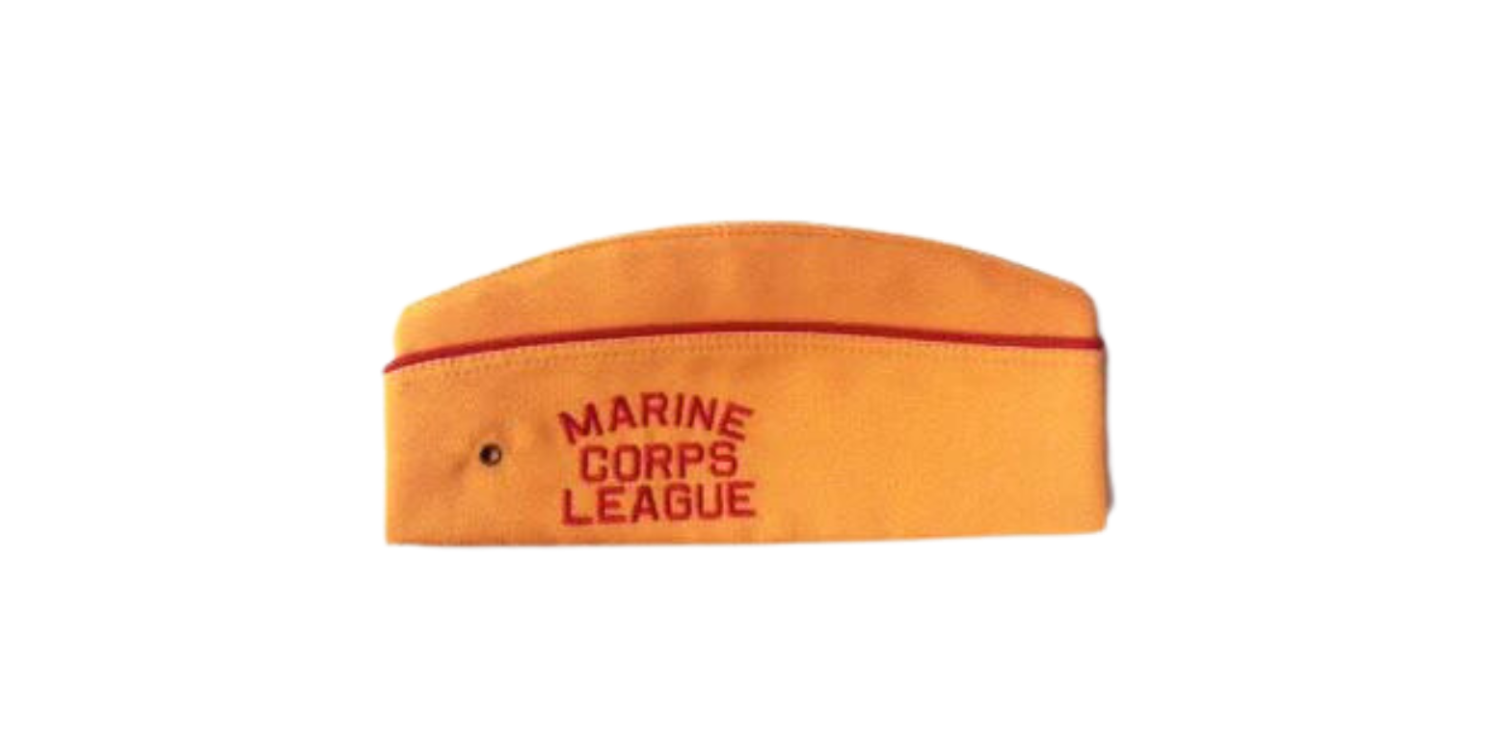
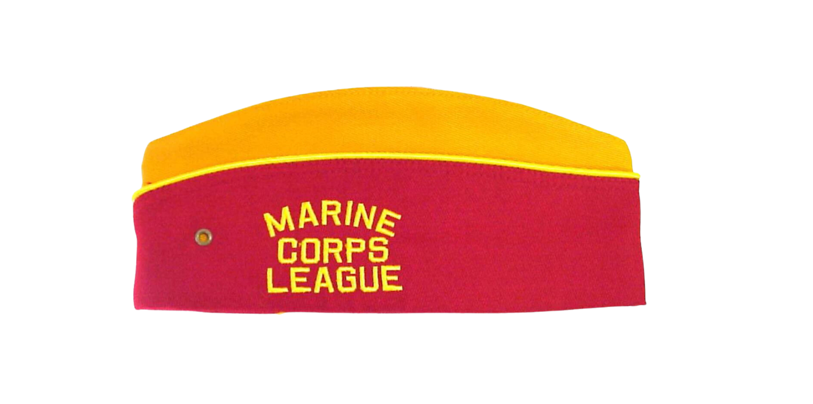
MALE STYLE COVERS
POUND LEVEL
PACK LEVEL
KENNEL LEVEL
WORN BY ALL DOGS, INCLUDES MARINE EAGLE GLOBE AND ANCHOR ON LEFT SIDE AND MODD MALE STYLE COVER PATCH ON FRONT RIGHT SIDE
WORN BY ALL CURRENT PACK OFFICERS AND PAST PACK LEADERS, INCLUDES MARINE EAGLE GLOBE AND ANCHOR ON LEFT SIDE AND MODD MALE STYLE COVER PATCH ON FRONT RIGHT SIDE
WORN BY ALL CURRENT KENNEL OFFICERS AND PAST DIVISION VICE CHIEF DEVIL DOGS, INCLUDES MARINE EAGLE GLOBE AND ANCHOR ON LEFT SIDE AND MODD MALE STYLE COVER PATCH ON FRONT RIGHT SIDE

Slide 7
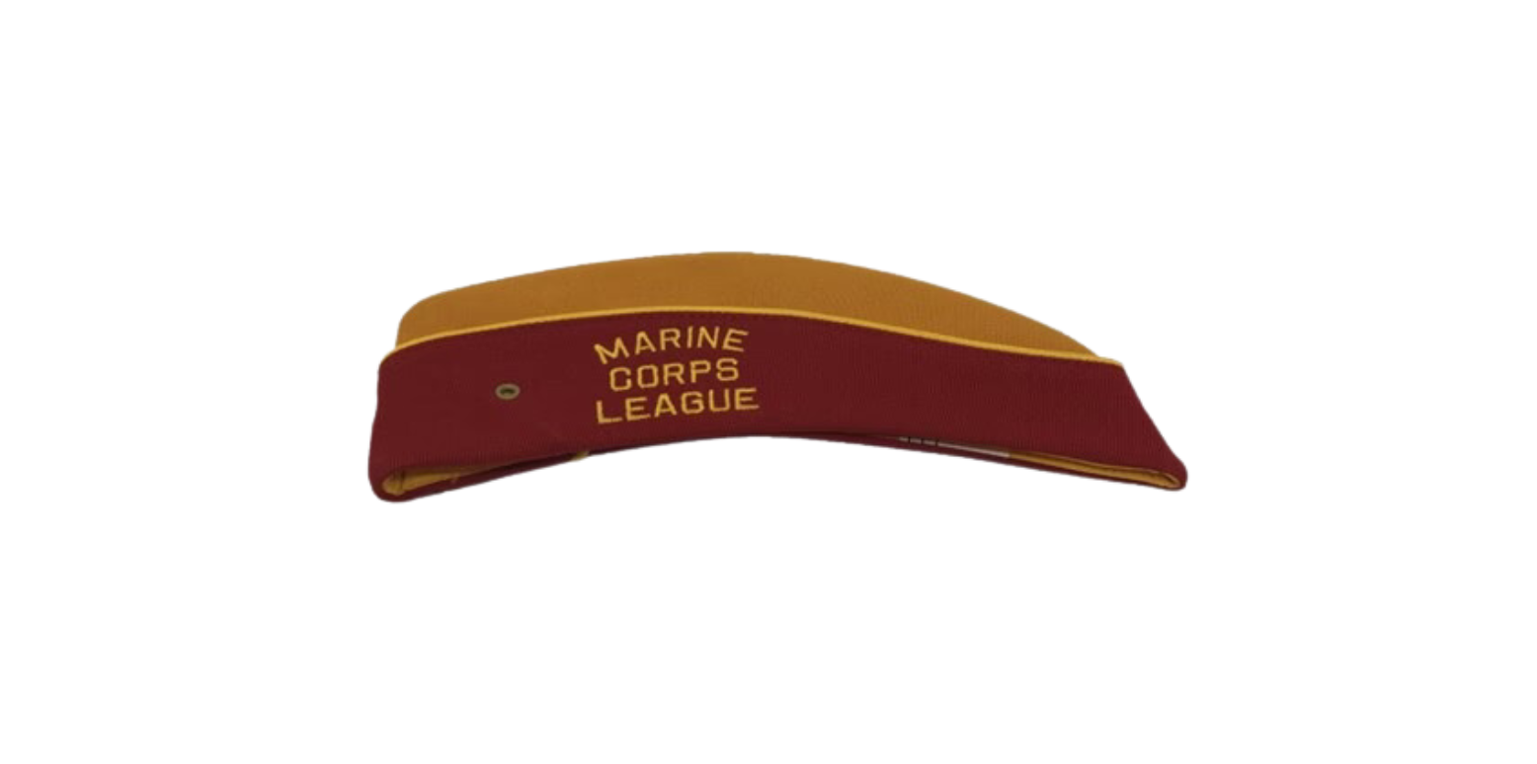
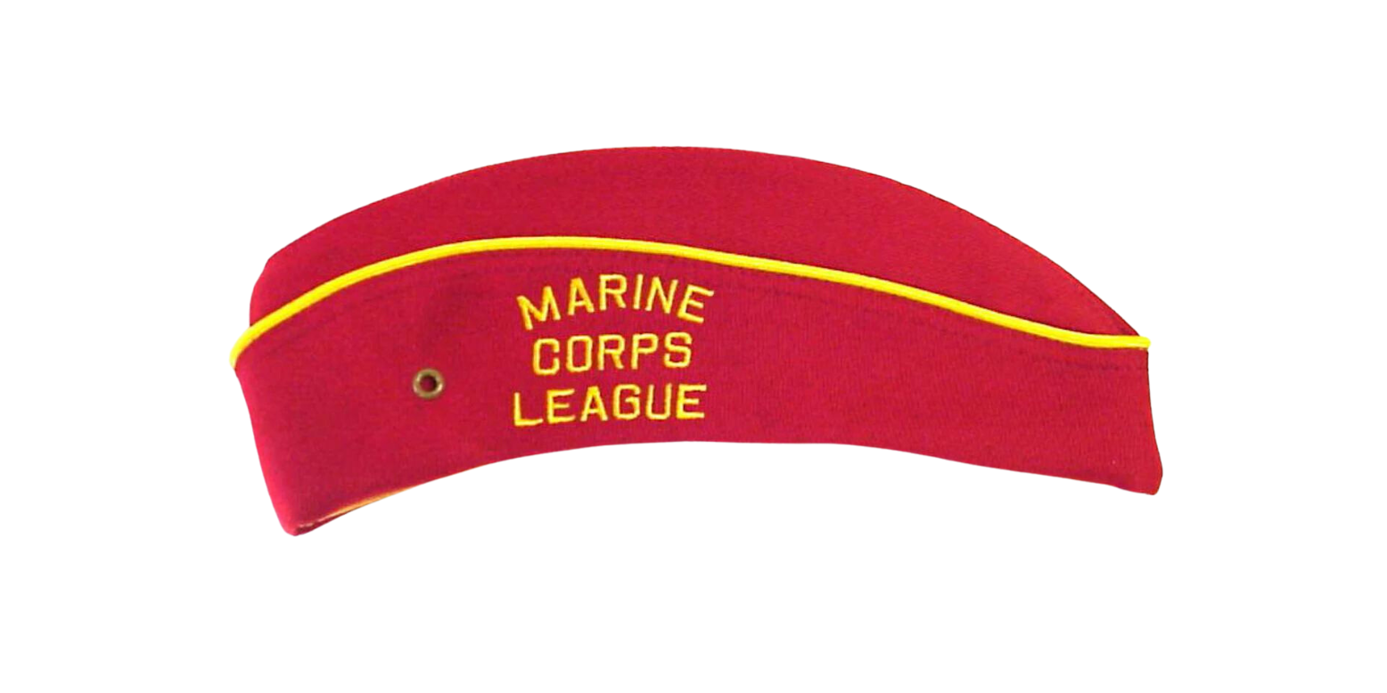
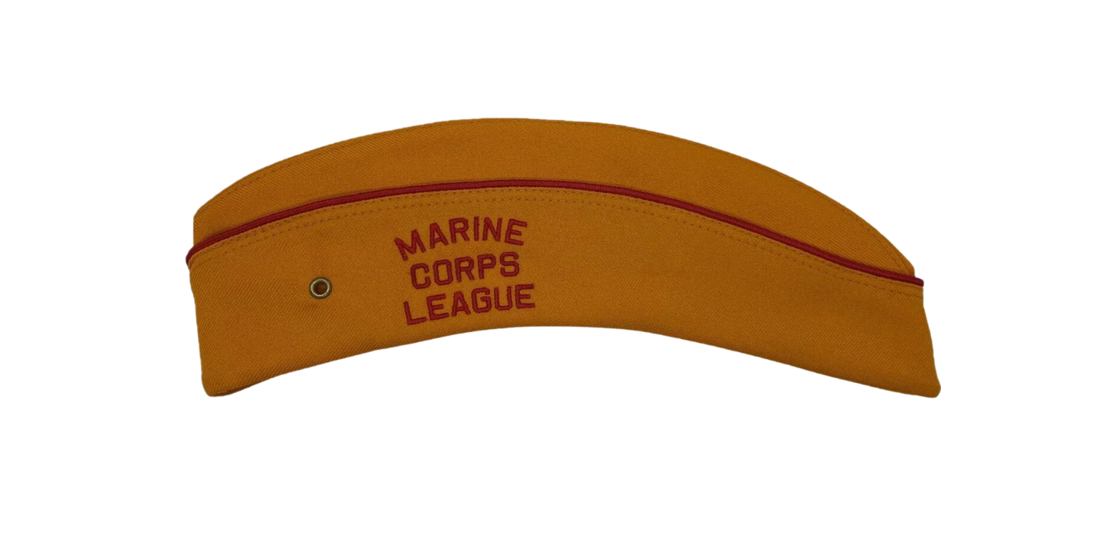
FEMAL STYLE COVERS ARE OPTIONAL COVERS FOR WEAR BY FEMALE DOGS
POUND LEVEL
PACK LEVEL
KENNEL LEVEL
WORN BY ALL DOGS, INCLUDES MARINE EAGLE GLOBE AND ANCHOR ON LEFT SIDE AND MODD FEMALE STYLE COVER PATCH ON FRONT RIGHT SIDE
WORN BY ALL CURRENT PACK OFFICERS AND PAST PACK LEADERS, INCLUDES MARINE EAGLE GLOBE AND ANCHOR ON LEFT SIDE AND MODD FEMALE STYLE COVER PATCH ON FRONT RIGHT SIDE
WORN BY ALL CURRENT KENNEL OFFICERS AND PAST DIVISION VICE CHIEF DEVIL DOGS, INCLUDES MARINE EAGLE GLOBE AND ANCHOR ON LEFT SIDE AND MODD FEMALE STYLE COVER PATCH ON FRONT RIGHT SIDE

Slide 8
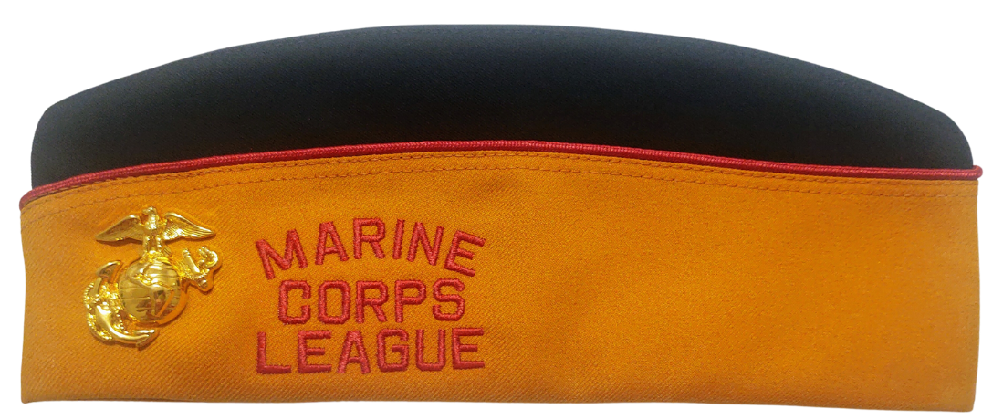
PAST CHIEF DEVIL DOG COVER
COVER WORN BY ALL PAST CHIEF DEVIL DOGS
GOLD KENNEL COVER WITH A BLACK CROWN

Slide 9
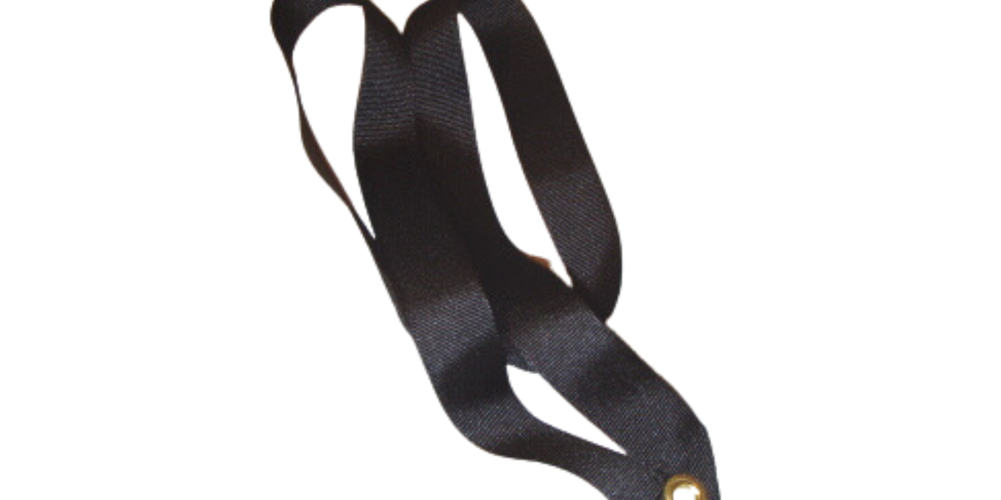
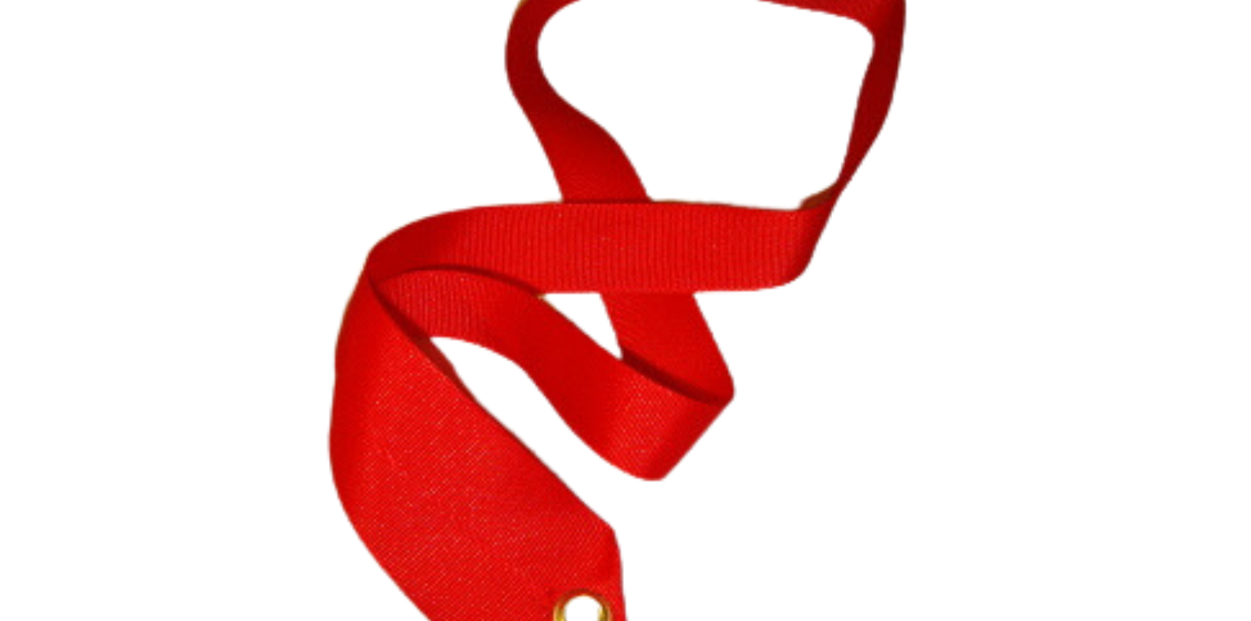
MODD DOG COLLARS
BLACK COLLAR
RED COLLAR
GOLD COLLAR
EARNED BY AND WORN BY ALL PUPS OF THE ORDER UPON THEIR OBLIGATION AS PUPS
EARNED BY AND WORN BY ALL DEVIL DOGS OF THE ORDER UPON THEIR INITIATION INTO THAT DEGREE. TRADITIONALLY DONE AT A GRAND GROWL OF THE PACK
EARNED BY AND WORN BY ALL PEDIGREE DEVIL DOGS UPON THEIR INITIATION INTO THAT DEGREE AT THE SUPREME GROWL
THE COLORS OF OUR MODD COLLARS ARE DERIVED FROM THE GERMAN FLAG AS A REFERENCE TO WHERE WE EARNED OUR TITLE OF TEUFEL HUNDEN (DEVIL DOGS). YOU MAY WEAR NO MORE THAN TWO EMBLEMS (PINS) ON YOUR MODD COLLAR. AMERICAN FLAG PIN, EGA PIN, MCL/MODD PINS, MILITARY SERVICE PINS, POW/MIA PINS, VAVS AWARD PINS AND THE BULLDOG. IF YOU WEAR MORE, PREPARE TO BE FINED.

Slide 10
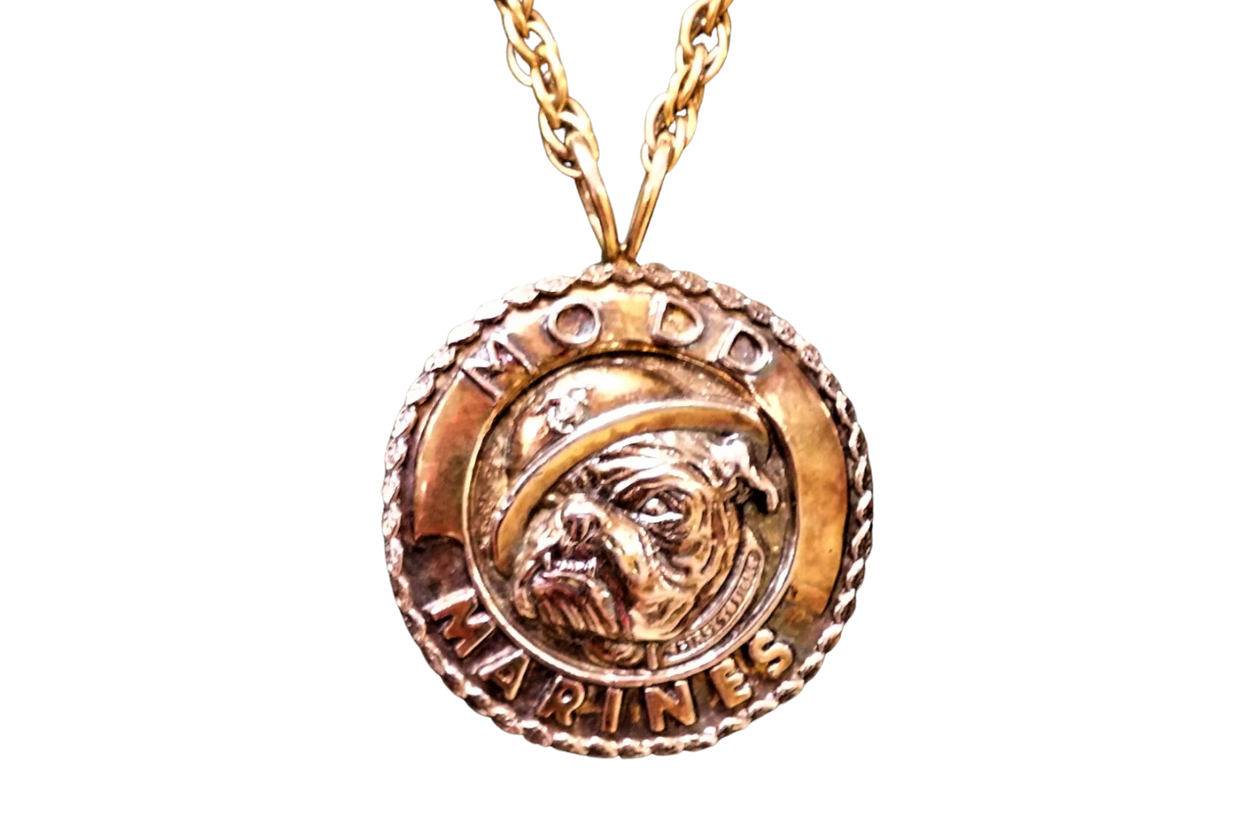
CHIEF DEVIL DOG BADGE OF OFFICE
ONLY THE CHIEF DEVIL DOG WEARS THIS DEVICE AND IT IS PASSED FROM ONE CHIEF DEVIL DOG TO THE NEXT.

Slide 11
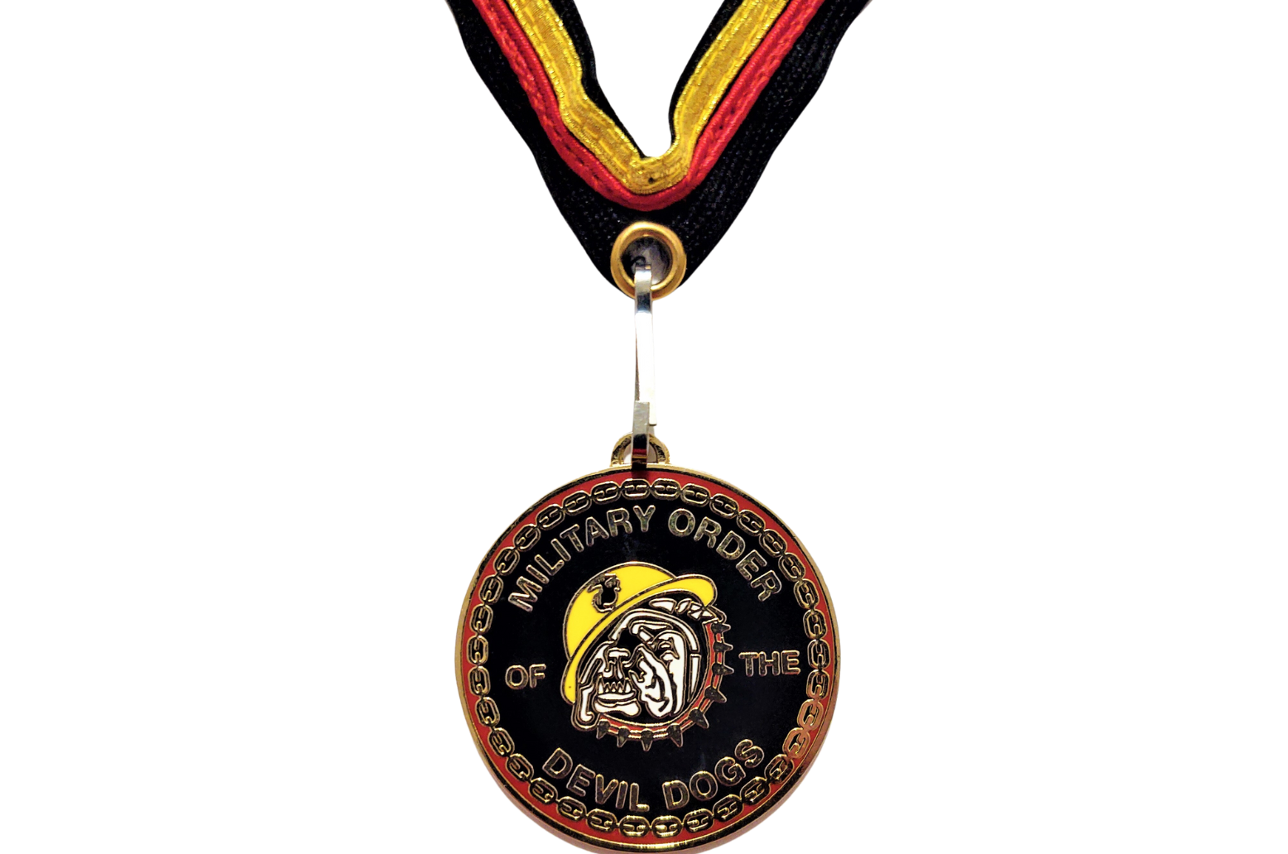
PAST CHIEF DEVIL DOG COLLAR AND TAG
ONLY PAST CHIEF DEVIL DOGS WEAR THE SPECIAL GOLD, RED, AND BLACK COLLAR FROM WHICH SHALL BE SUSPENDED THEIR MINITURE PAST CHIEF’S BADGE OF OFFICE.

Slide 12
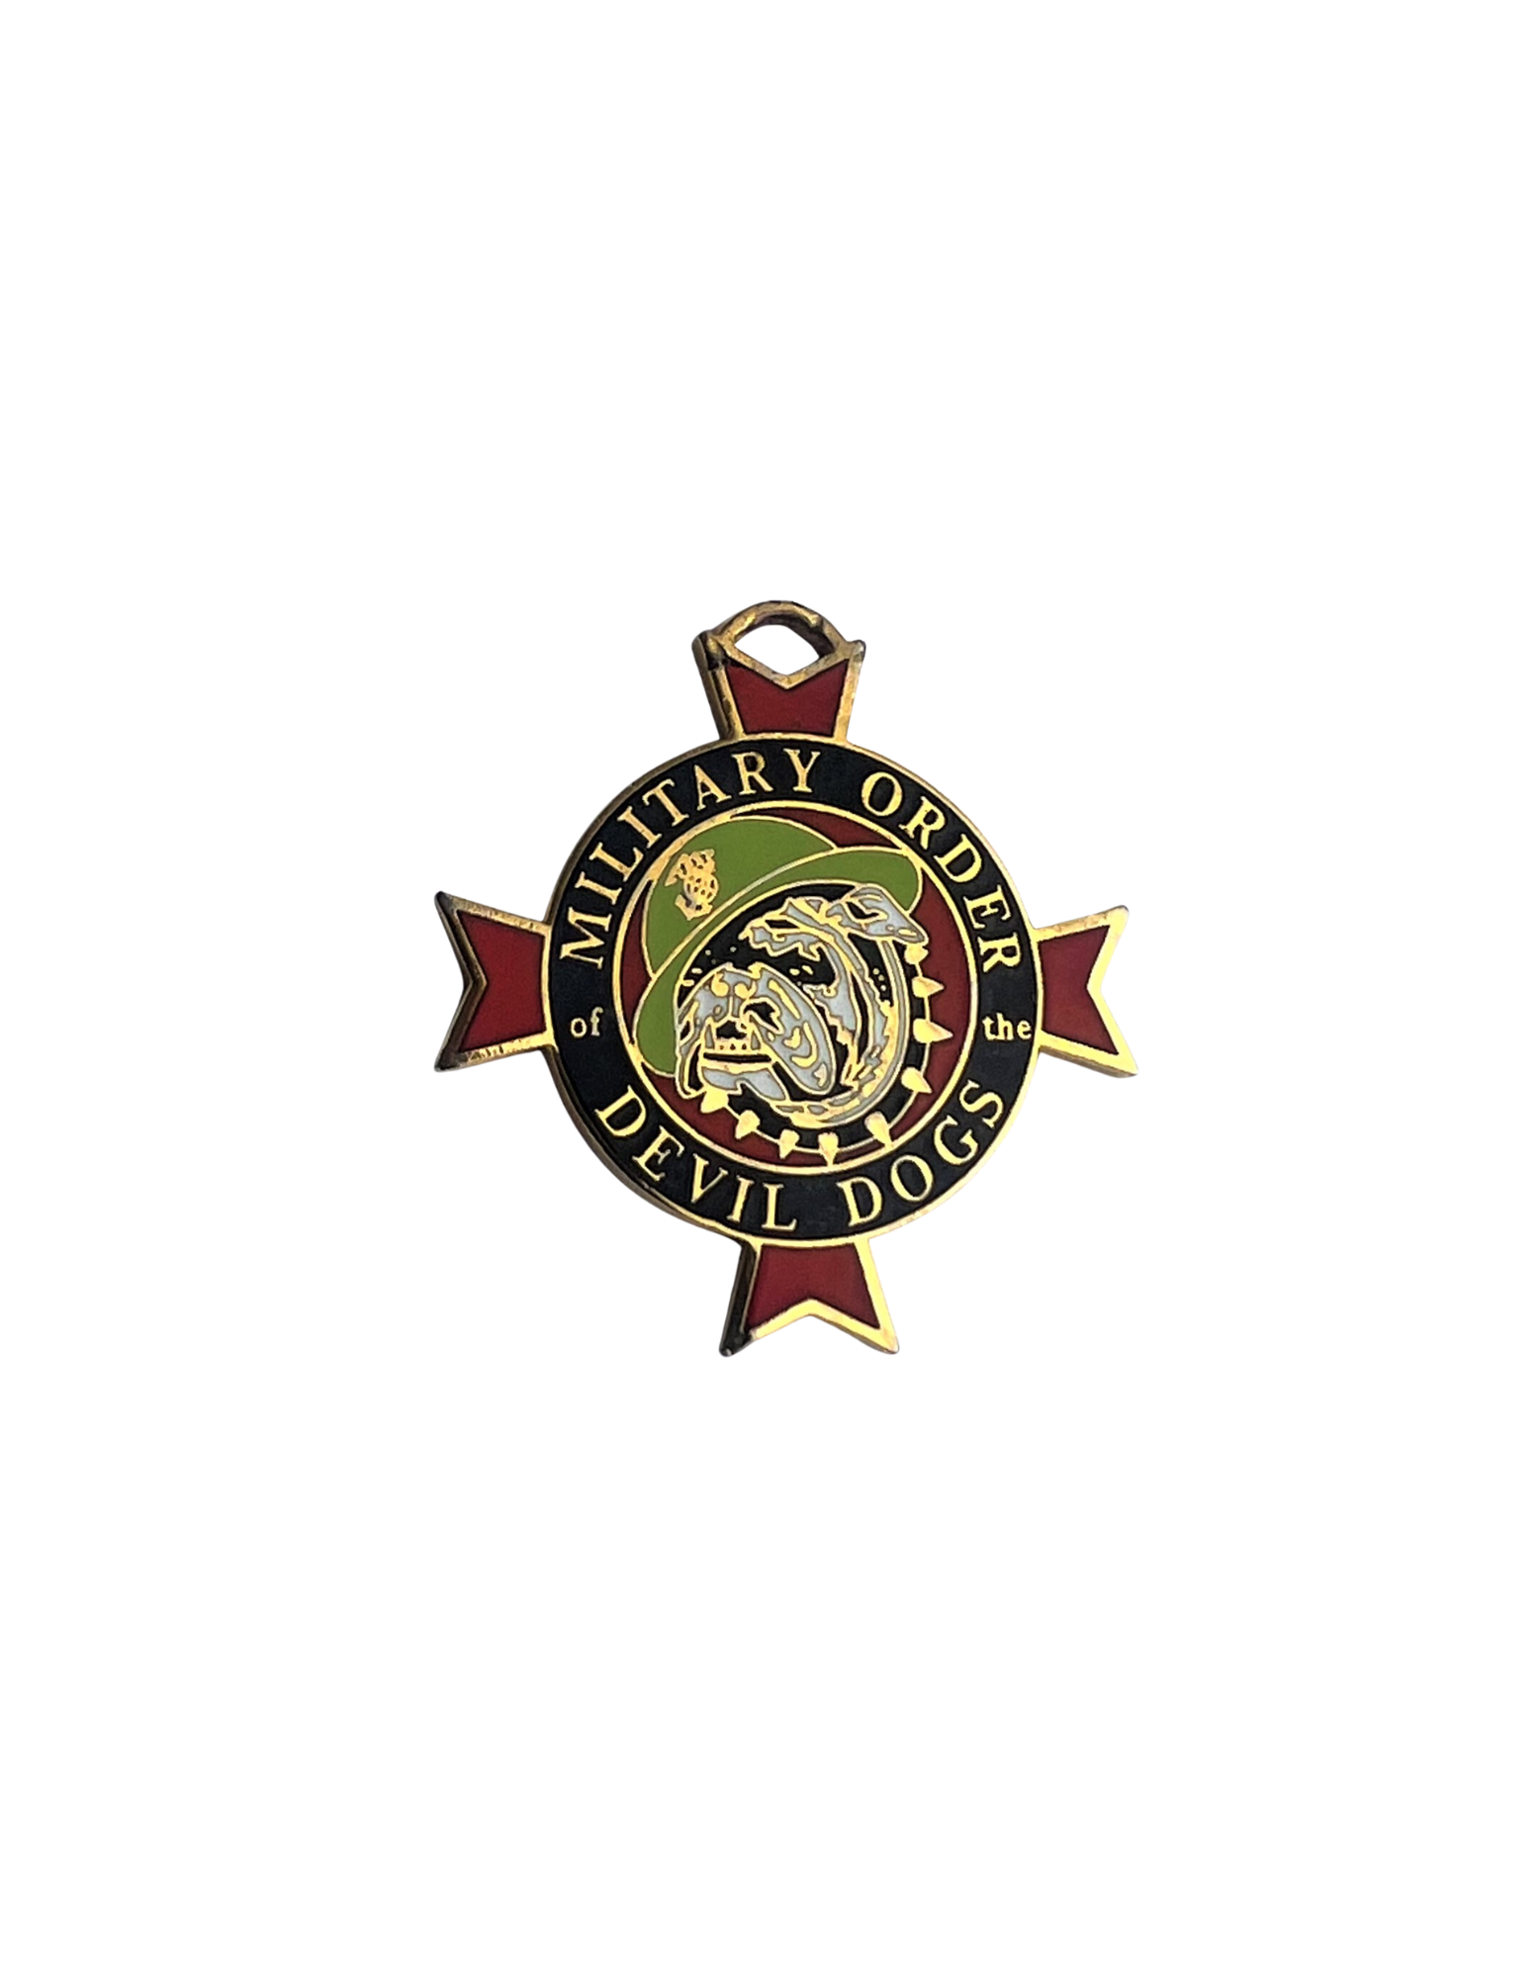
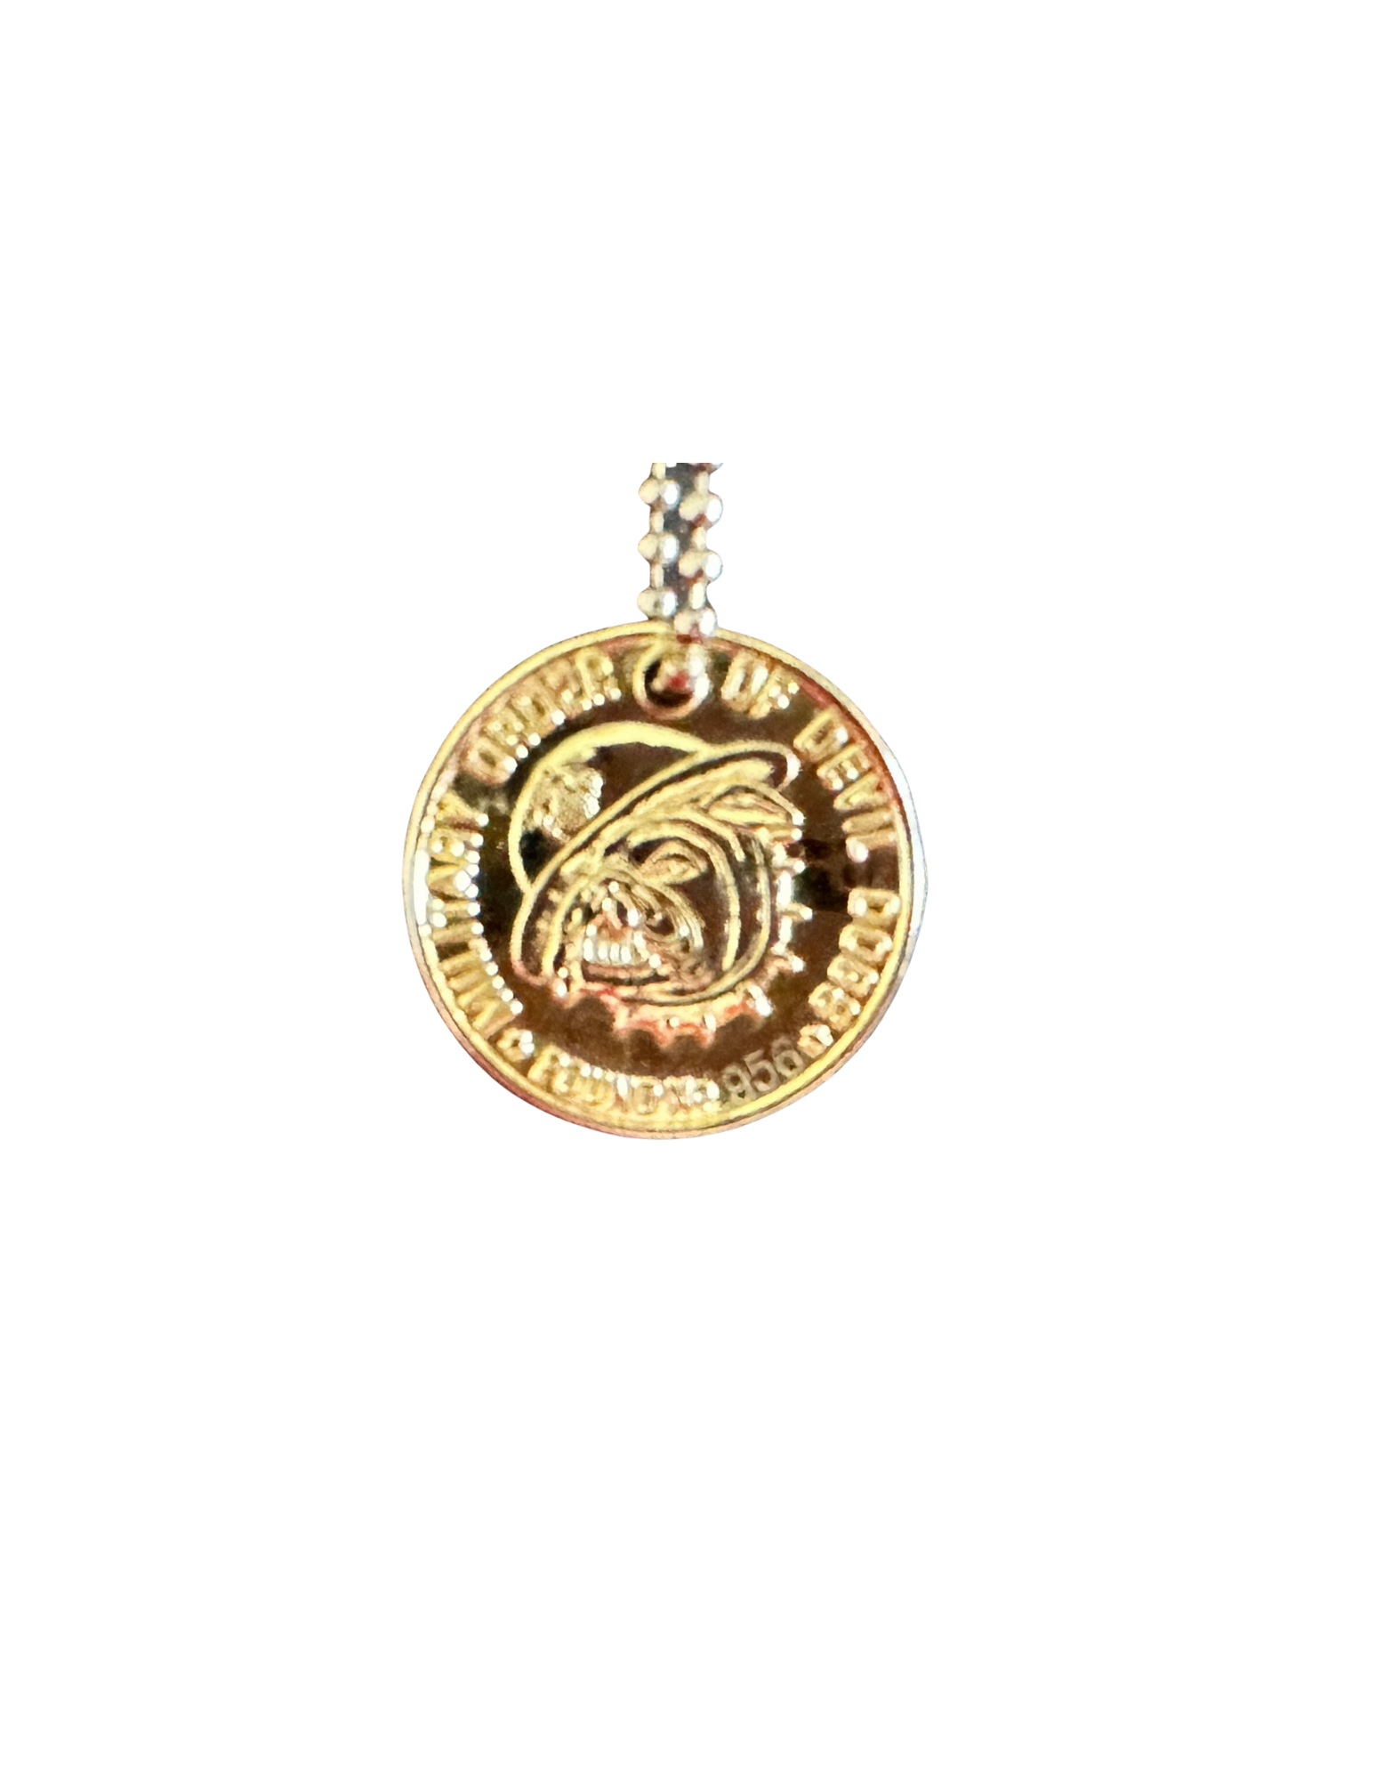
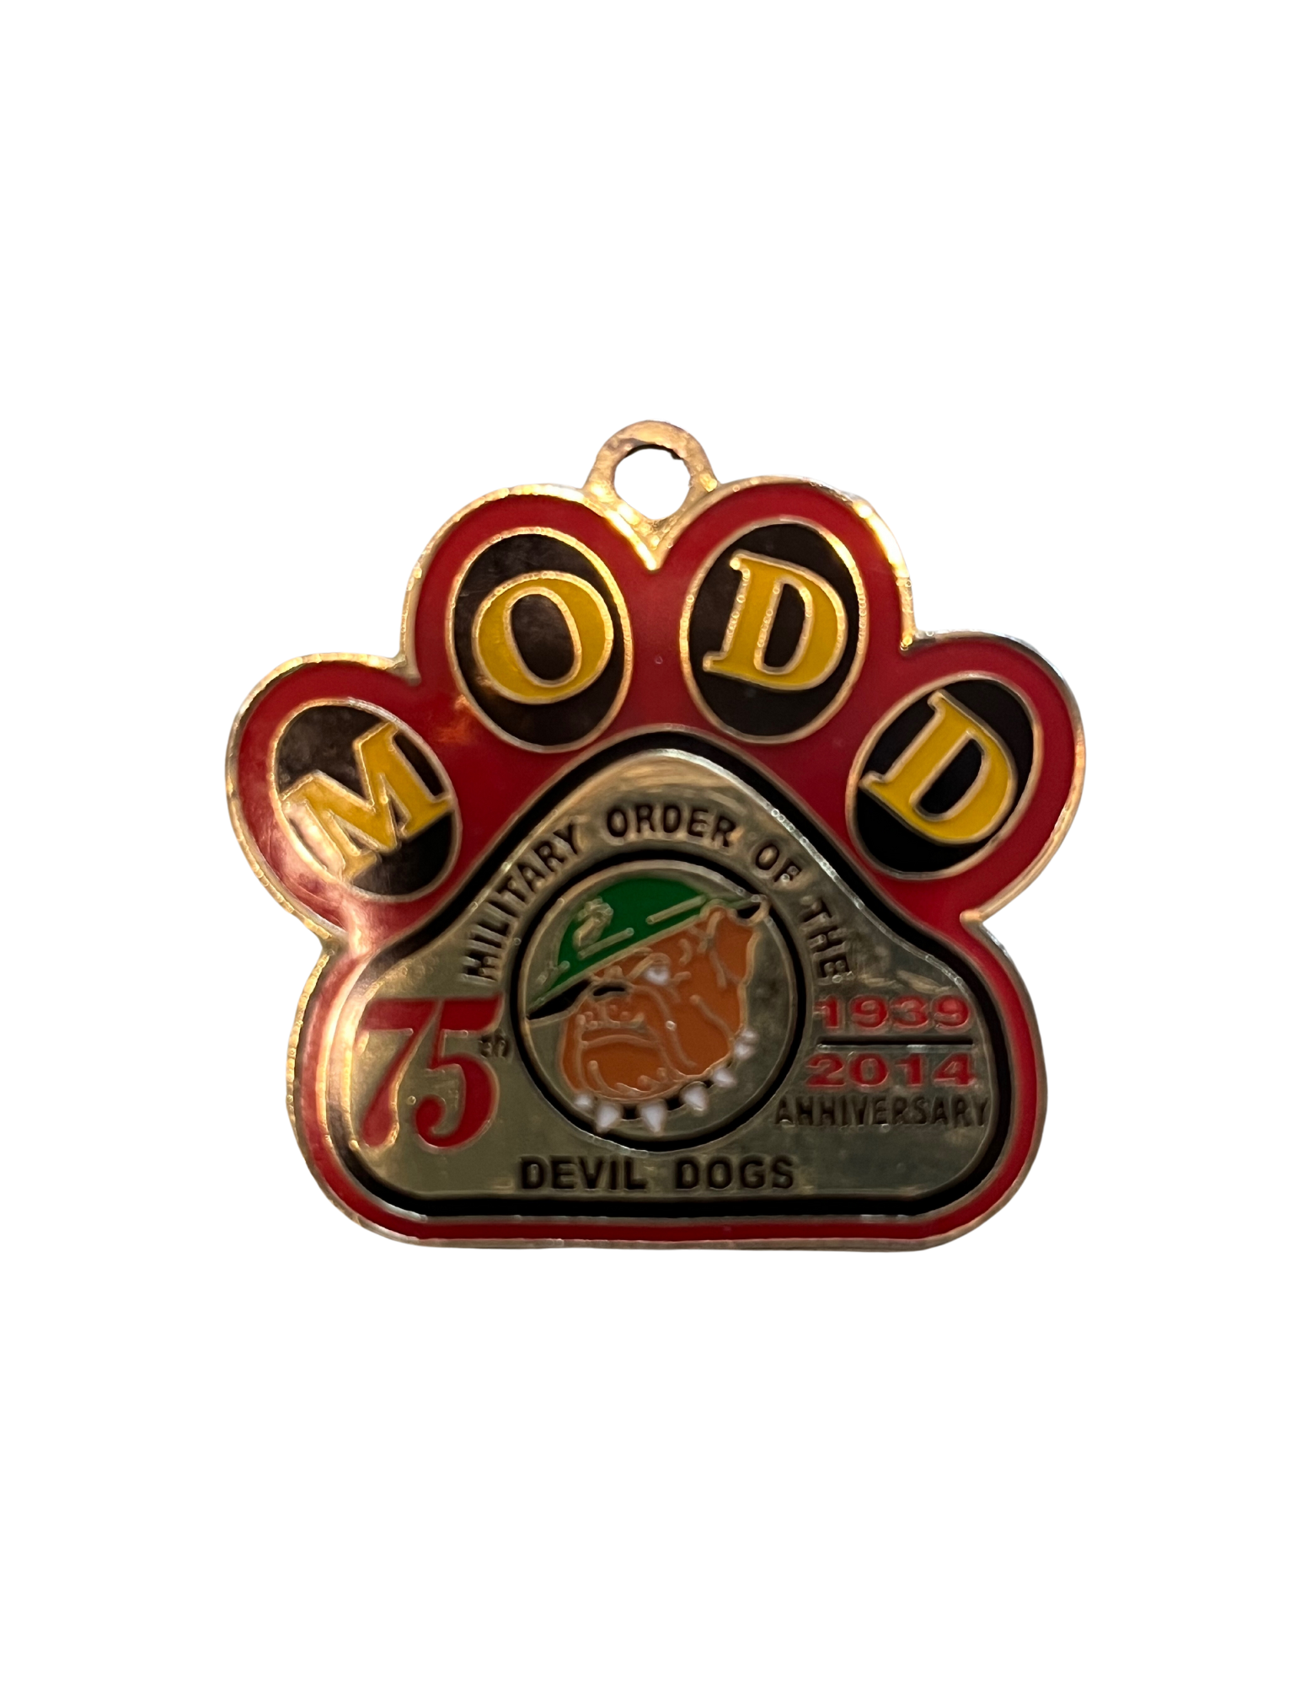
MODD DOG TAGS – SILVER, GOLD,
50th & 75th ANNIVERSARY MEDALLIONS
ONE MODD DOG TAG AND/OR ANNIVERSARY MEDALLIONS WILL BE WORN ON YOUR MODD DOG COLLAR

Slide 13
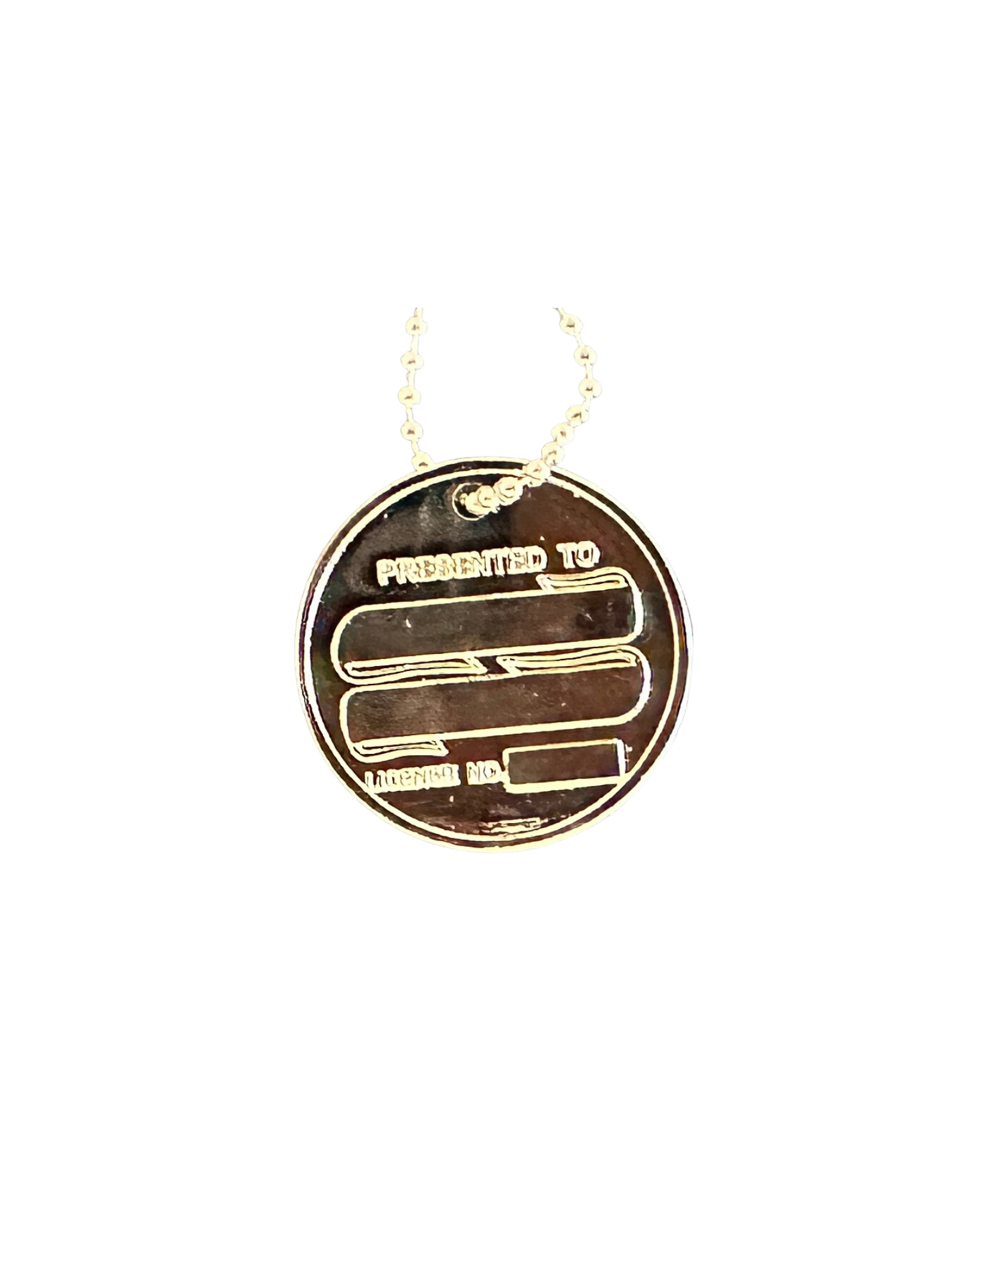
MODD DOG TAGS – ALL MEMBERS FRONT/REVERSE
SILVER DISC –
  FRONT
    POUND # ENGRAVED ON FRONT
  REVERSE
    FIRST INITIAL, LAST NAME ON 1ST LINE
    PACK ON 2ND LINE
    MODD DOG TAG # ON 3RD LINE
  EXAMPLE:
    J. SMITH
    OHIO
    07-085

Slide 14
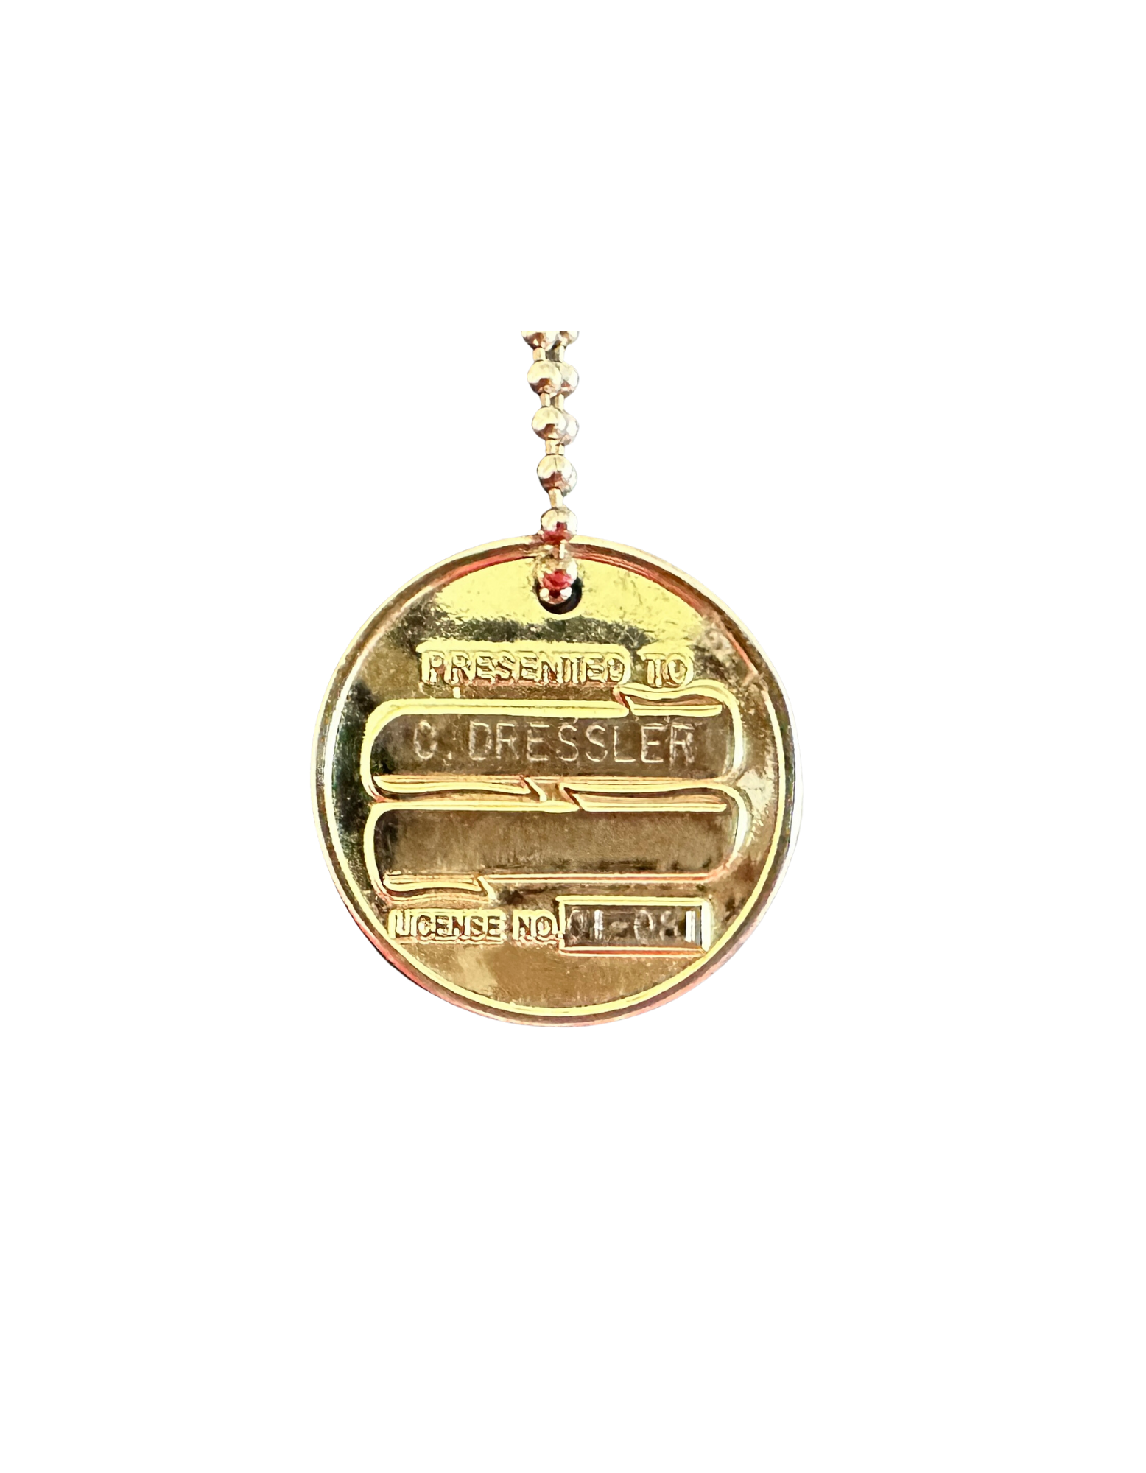
MODD DOG TAGS – KENNEL STAFF FRONT/REAR
GOLD DISC –
  FRONT
    POUND # ENGRAVED ON FRONT
  REVERSE
    FIRST INITIAL, LAST NAME ON 1ST LINE
    WHEN STAFF SERVICE IS COMPLETE, ENGRAVE WITH HIGHEST OFFICE HELD
    MODD DOG TAG # ON 3RD LINE
  PAST KENNEL STAFF MAY RETAIN AND CONTINUE TO WEAR THEIR GOLD MODD DOG TAG

Slide 15
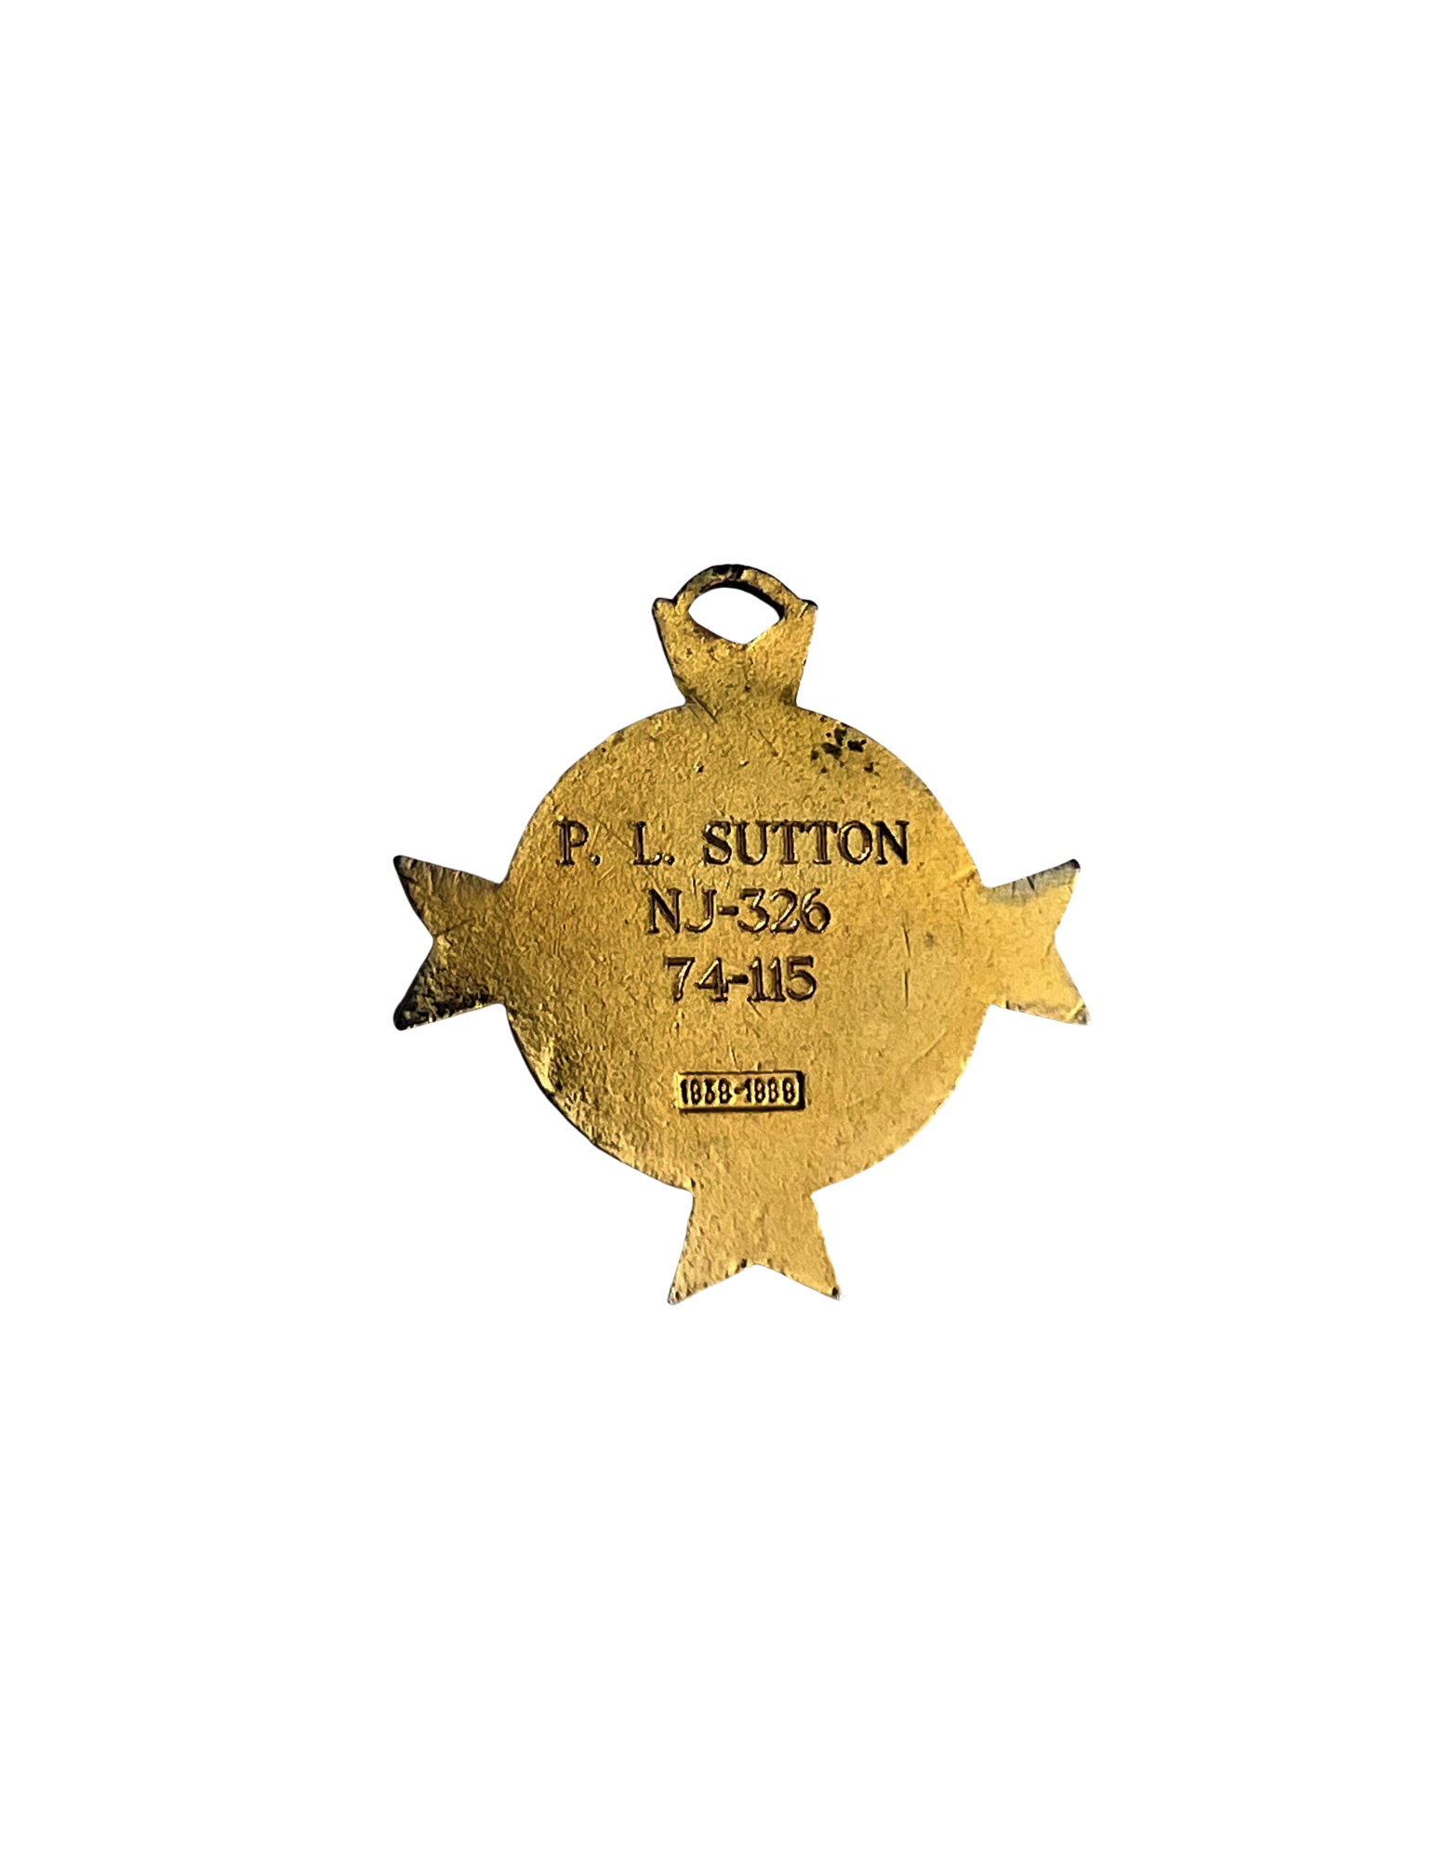
MODD DOG TAGS – 50TH ANNIVERSARY FRONT/REAR
ENGRAVED ON REVERSE ONLY
1ST LINE – 1ST INITIAL OR 1ST AND MIDDLE INITIAL AND LAST NAME
2ND LINE – PACK 2 LETTER ABBREVIATION AND POUND #
3RD LINE – MODD DOG TAG #

Slide 16
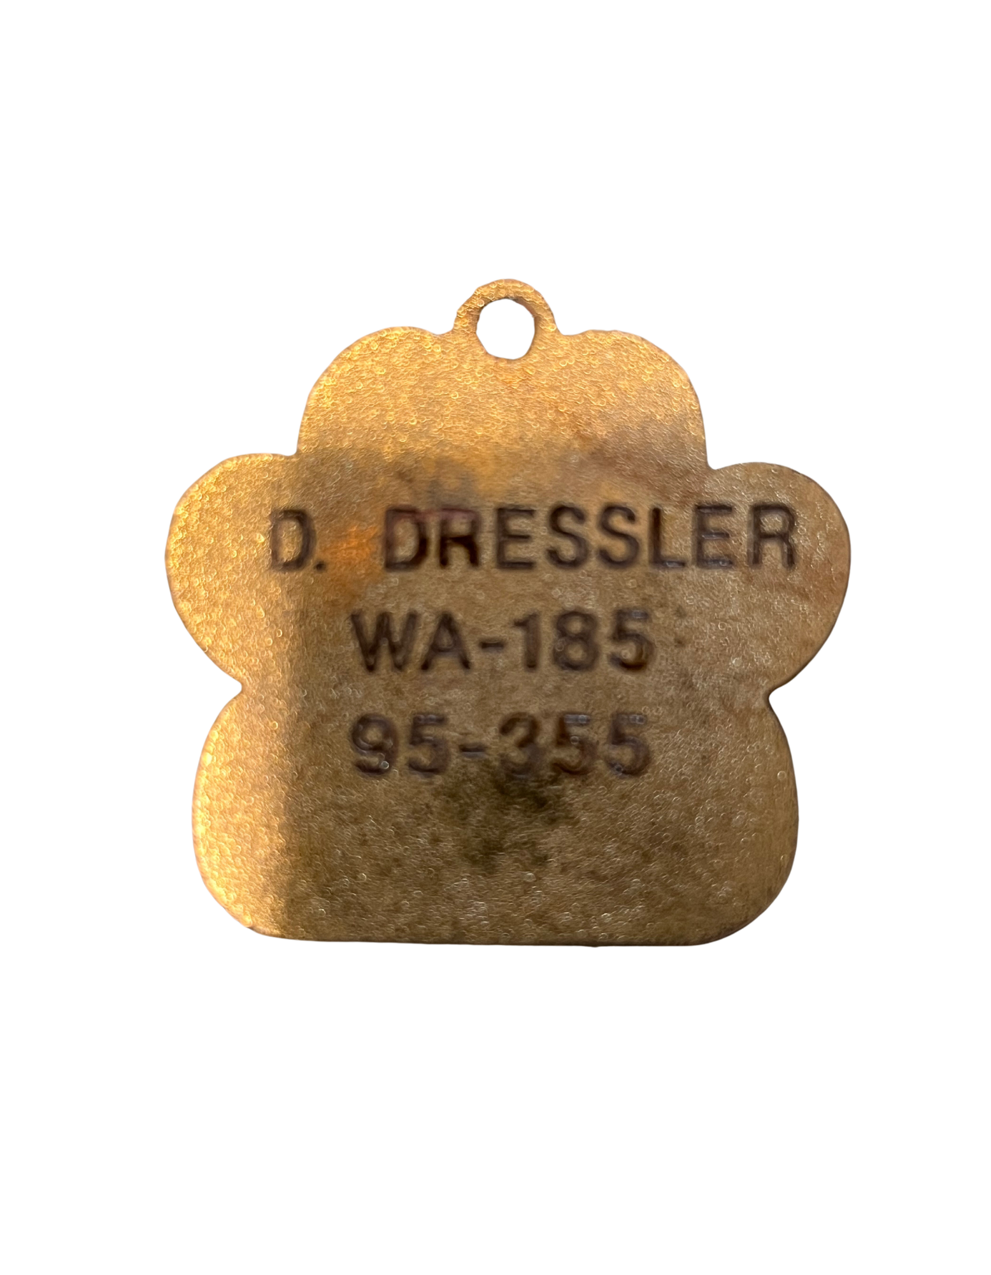
MODD DOG TAGS – 75TH ANNIVERSARY FRONT/REAR
ENGRAVED ON REVERSE ONLY
1ST LINE – 1ST INITIAL OR 1ST AND MIDDLE INITIAL AND LAST NAME
2ND LINE – PACK 2 LETTER ABBREVIATION AND POUND #
3RD LINE – MODD DOG TAG #

Slide 17
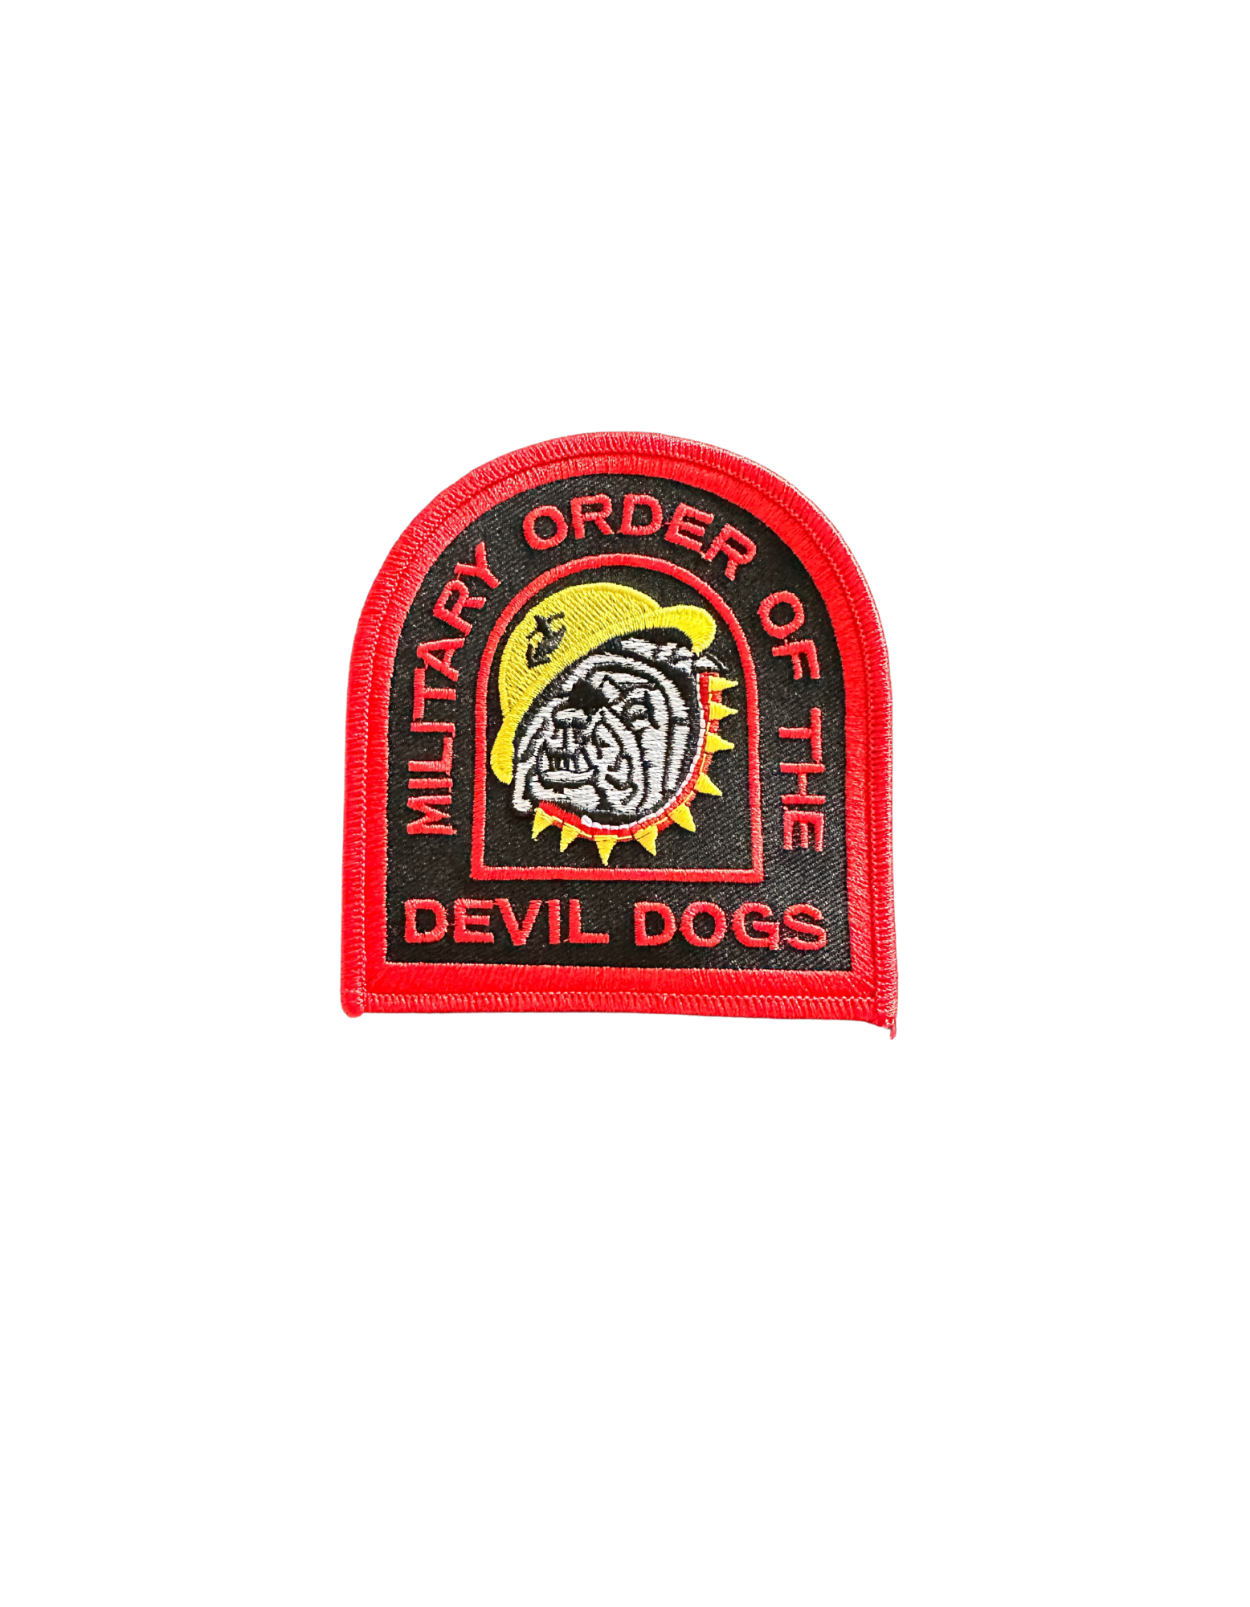
OPTIONAL ITEMS TO WEAR WITH MCL UNIFORM
MAY WEAR YOUR MODD COLLAR
MAY WEAR AN MODD SHOULDER PATCH (PICTURED AT RIGHT) IN LIEU OF AMERICAN FLAG PATCH ON RIGHT SHOULDER OF THE WHITE UNDRESS UNIFORM SHIRT (SHORT AND LONG SLEEVE)
PLACED 1½ INCHES BELOW THE SHOULDER SEAM AND CENTERED ON THE SLEEVE

