Slide 1


OBEDIENCE SCHOOL
Who Says You Can’t Teach an Old Dog New Tricks (Hint it’s Chief Taylor)

Slide 2
DEVIL DOG’S CREED
By PDD George E. Williams, August 1989
(Modified, August 2008)
I am an American, I was born in France. I hold the title of United States Marine, and understand the commitment of holding the title, Devil Dog. It is a tradition born at Belleau Wood in the year 1918, of a force in readiness and the “First to Fight.” As a Devil Dog, I ask no quarter and give no quarter. I will do everything in my power to uphold the objectives of the Military Order of the Devil Dogs and to carry out my duties to a swift and satisfactory completion.

Slide 3
Knowing Heads From Tails
The Who, What, When, Where, Why, and How of being a member of the M.O.D.D.
This Presentation is designed to Teach, Re-Familiarize, Reacquaint and Refresh Dogs at all Levels
Many of us have years of experience of being members of the M.O.D.D. but no Dog knows everything
Reviewing each of the sections of this presentation will help you become more proficient and efficient at being a member of the Order
The great pleasure of being a Dog is that you may make a fool of yourself with them and not only will they not scold you, but they will make a fool of themselves too

Slide 4

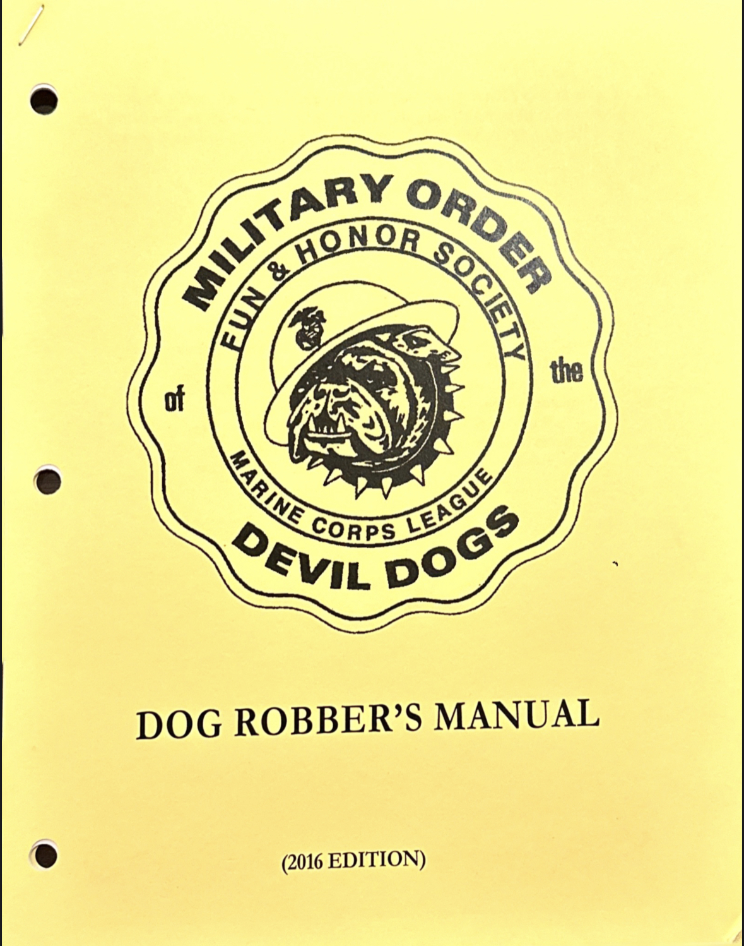


Know and use the Tools Available

Slide 5
Every Devil Dog started as a Pup
Remember this, if your Pound or Pack has no Pups, it has no new growth
Every Detachment has its share of outstanding Marines/FMF Navy Personnel; now all you need to do is invite them to become Dogs.
So, what are you waiting for? Let’s get Started

Slide 6
Lessons
Overview
Dog Speak
Reporting
Passports
Uniforms
Pound Officer’s Duties
How to run a Growl
How to start a Pound
How to reinstate a Pound
Awards
Forms

Slide 7
Lessons
www.militaryorderofthedevildogs.org
www.MODDKennel.org
Either URL will get you to the same site.

